Slide 1
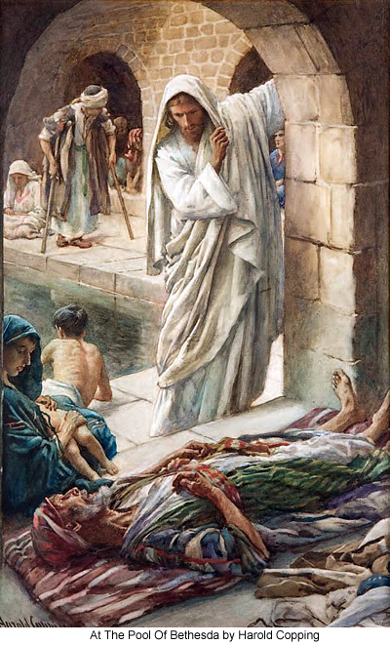
“Take up thy bed and walk”
Fort Bragg, 5-25-2013

Slide 2
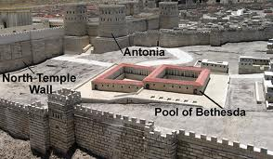
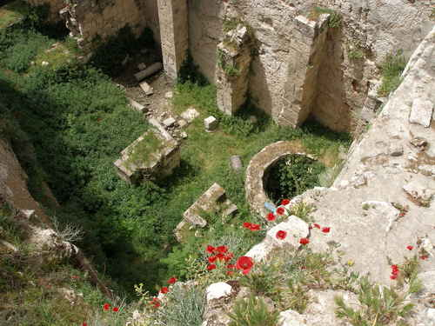
Bethesda: beth (house); hesda (mercy or grace)
8th C. BC a dam built across the short Beth Zeta valley creating a reservoir for rain water. A rock-cut channel brought a steady stream of water into Jerusalem.
This reservoir became known as the Upper Pool (2 Ki. 18:17; Isa. 7:3)
Around 200 BC a second pool was added to the south, 13 meters deep
Notes:
History:
The pool goes back to the 8th century BC, when a dam was built across the short Beth Zeta valley, turning it into a reservoir for rain water; with a sluice-gate in the dam allowing for the height of the water to be controlled. A rock-cut channel brought a steady stream of water from the reservoir into the city. The reservoir became known as the Upper Pool (בריכה העליונה). The Upper Pool is mentioned in the Book of Kings (2 Ki. 18:17) in a passage repeated in the Book of Isaiah (7:3). Around 200 BC a second pool was added on the south side of the dam; with a depth of 13 meters, 39 feet (the word for pool is kolumbēthron, coming from the verb kolumban, to dive.).

Slide 3
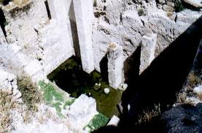
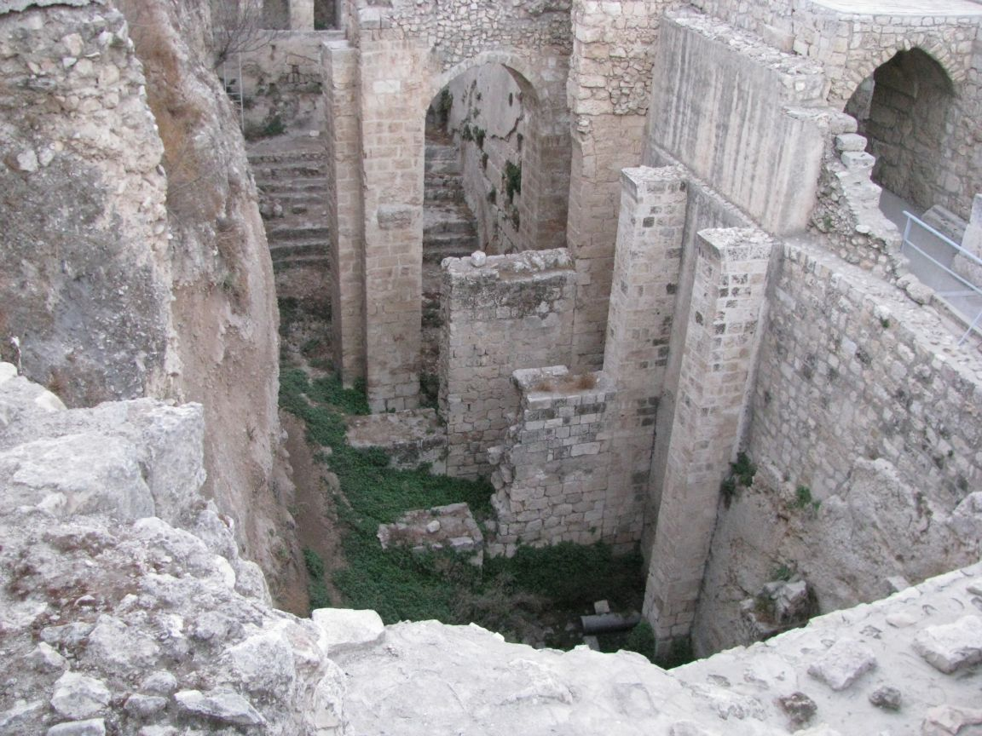
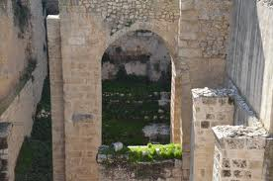
Bethesda
1st. Century BC, natural caves to the east of the two pools were turned into small baths
They became part of an asclepieion (a place of healing for the Roman god Asclepius).
At mid 1st. Century AD, Agrippa expanded the city walls bringing the pools within the city, turning it into a large temple
Pictured are those ruins today
Notes:
In the 1st century BC, natural caves to the east of the two pools were turned into small baths, as part of an asclepieion (a place of healing by the Roman God of healing, Asclepius (worshipped as Saviour (Greek: Soter), in reference to his healing attributes).
At mid 1st century AD, Herod Agrippa expanded the city walls, bringing the asclepieion within the city. When Hadrian rebuilt Jerusalem as Aelia Capitolina, he placed a roadway along the dam, and expanded the asclepieion into a large temple to Asclepius and Serapis.^{[24]}

Slide 4
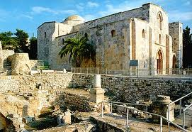
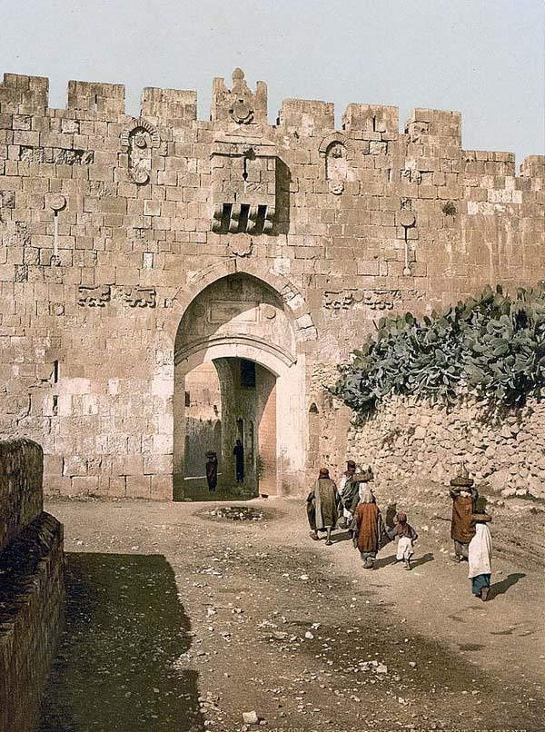
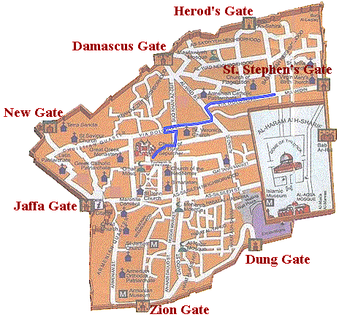
After the Crusades, the temple was replaced with a church named in honor of Saint Anne (grandmother of Jesus)
That church was given to France who rebuilt it in the late 19th century.
The location, history and archeology prove John description was correct:
In name
Location – near sheep Gate
Five porticos with running water
Notes:
After the Crusader conquest of Jerusalem, the church buildings were rebuilt on a smaller scale with a new church named in honor of Saint Anne (completed in 1138 AD) was erected nearby. It was built over the site of a grotto believed by the Crusaders to be the birthplace of Anne, grandmother of Jesus.
After the conquest of Jerusalem by Saladin it was transformed into a school, gradually the buildings fell into ruin. In the early 19th century, the Ottoman Empire in 1856 gave the site to France who constructed the Church of Saint Anne, at the south east corner of the site, leaving the ancient ruins untouched.
The pool is located to the north part of the Temple Mount, near what is now called St. Stephen's Gate, which is, in fact, the site of the Sheep Gate mentioned here. In these porches, set at various levels around the pool, during our Lord's time it was the habit of many to gather during feast days, hoping for a healing miracle.
Archeological digs conducted in the 19th century, Schick discovered a large tank situated about 100 feet north-west of St. Anne's Church which he contended was the Pool of Bethesda. Further archaeological excavation in the area, in 1964, discovered he was correct.
Also Lion’s Gate or Sheep Gate) is located in the Old City Walls of Jerusalem, one of seven open gates in Old Jerusalem’s Walls. It’s entrance marks the beginning of the traditional Christian observance of the last walk of Jesus from prison to crucifixion (the Via Dolorosa).
All together, the Old City walls contain 43 surveillance towers and 11 gates, seven of which are presently open.

Slide 5
the setting
The 5th chapter marks a major shift in John
In his prologue (Chapt. 1) he introduces his theology of Jesus (who he is and why he was rejected)
Chapters 1-4 Jesus launches his ministry with individuals:
his disciples
Galileans
Judah
Temple cleansing
Nicodemus
Samaritans
Woman at the well
Chapter 5 –the hostility and violent rejection from his own kinsmen begins.

Slide 6
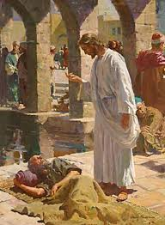
The paralytic at Bethesda
Vss. 1-5 “Soon another Feast came around and Jesus was back in Jerusalem. Near the Sheep Gate in Jerusalem there was a pool, in Hebrew called Bethesda, with five alcoves. Hundreds of sick people—blind, crippled, paralyzed—were in these alcoves. One man had been an invalid there for thirty-eight years.
Notes:
After his ministry in Galilee. The year is AD 29 likely the Passover
The sheep gate was the one through which the sacrificial animals were brought into the temple.
[omitting “waiting for the moving of the water. For an angel went down at a certain season into the pool, and troubled the water: whosoever then first after the troubling of the water stepped in was made whole of whatsoever disease he had]
If you have any Bible other than the King James Version you will notice that the last part of verse 3 and all of verse 4 is missing. Many versions include the verse in a footnote with explanations. It was superstitiously believed that from time to time when the water was troubled -- when it would rise rapidly and then sink again -- this was caused by an angel who visited the pool, and the first man who got into it when it was so troubled would be healed.
This is akin to what is found in Lourdes, in southern France, where there is a spa which many believe has healing capacities. The shrine of Guadalupe, in Mexico City, has thousands of crutches stacked along its walls where people have been healed in this special place where they thought they could receive a blessing from God.
Like many similar pools in the Jerusalem area, an intermittent spring releases water in surges from hidden reservoirs in the hills around the city, causing these springs to rise and fall suddenly. This gave rise to the superstition about an angel troubling the pool. Undoubtedly healings did occur there. Even today healings take place in these special areas where people go, believing they can be healed. When people believe they are going to be healed, and they are in a place where healings supposedly occur, and they do the expected thing, many of them are healed. Thus the pool at Bethesda had established a reputation as a place where people could be healed.
“Hundreds of sufferers visited the place; but so great was the crowd when the water was troubled that they rushed forward, trampling underfoot men, women, and children, weaker than themselves. Many could not get near the pool. Many who had succeeded in reaching it died upon its brink. Shelters had been erected about the place, that the sick might be protected from the heat by day and the chilliness of the night. There were some who spent the night in these porches, creeping to the edge of the pool day after day, in the vain hope of relief.” (DA 201.2)
“Jesus was again at Jerusalem. Walking alone, in apparent meditation and prayer, He came to the pool. He saw the wretched sufferers watching for that which they supposed to be their only chance of cure. He longed to exercise His healing power, and make every sufferer whole. But it was the Sabbath day. Multitudes were going to the temple for worship, and He knew that such an act of healing would so excite the prejudice of the Jews as to cut short His work.” (DA 201.3)
He did not empty the five porches, healing everybody. He did not invite them all to come down so that he might lay hands on them; nothing of that sort. He went to only one man. (Stedman)
“But the Saviour saw one case of supreme wretchedness. It was that of a man who had been a helpless cripple for thirty-eight years. His disease was in a great degree the result of his own sin, and was looked upon as a judgment from God. Alone and friendless, feeling that he was shut out from God's mercy, the sufferer had passed long years of misery. At the time when it was expected that the waters would be troubled, those who pitied his helplessness would bear him to the porches. But at the favored moment he had no one to help him in. He had seen the rippling of the water, but had never been able to get farther than the edge of the pool. Others stronger than he would plunge in before him. He could not contend successfully with the selfish, scrambling crowd. His persistent efforts toward the one object, and his anxiety and continual disappointment, were fast wearing away the remnant of his strength.” (DA 202.1)

Slide 7
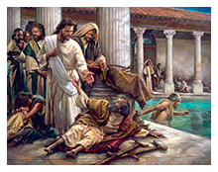
When Jesus saw him stretched out by the pool and knew how long he had been there, he said, “Do you want to get well?” vs. 6
Notes:
What a strange question to ask of a man who had been sick for 38 years! "Do you want to be healed? But Jesus never asked a foolish question in his life. Obviously it was important for this man to answer (at least to himself) the question, "Do I want to be healed?" (Stedman)
You cannot help somebody who does not want to be helped. They are not ready to admit they cannot make it on their own. They are determined to get into the water when it is troubled, to not look elsewhere for help. Jesus can do nothing for them. (Stedman) Recently I told my wife and others, “I am ready to die.” Life is too hard, too filled with problems, just work, work, work! Depressed people would understand the need for this question. Do they really want to face the challenges of life? If not, then the cruelest thing to do would be heal them…
Jesus always comes offering the impossible…
“The sick man was lying on his mat, and occasionally lifting his head to gaze at the pool, when a tender, compassionate face bent over him, and the words, ‘Wilt thou be made whole?’ arrested his attention. Hope came to his heart. He felt that in some way he was to have help.” (DA, 202.2)
“the glow of encouragement soon faded. He remembered how often he had tried to reach the pool, and now he had little prospect of living till it should again be troubled. He turned away wearily, saying,” (DA 202.2)

Slide 8
The Power of Faith:
Heb. 11:
What Faith can do… provide evidence of things unseen - vs. 1
Elders were able to obtain success in the church – vs. 2
Words create reality, all that we see were the result of simply God’s words - vs. 3
Abel acting on the words of God became righteous - vs. 4
By believing, Enoch walked right into heaven – vs. 5
Noah, by God’s word built his ark (120 yrs. a building, see Gen. 6:3, 7:6 SDABD p. 800) saved a remnant of life to a new world, became righteous, all by faith – vs. 7
Abraham, heard God speak to him, and responded to his words, and became the father of God’s people, overcoming all his faithlessness – vss. 7-19
Moses, accepted his heavenly birthright, leading his people out of Egypt and to the promised land – vss. 23-29
Rahab (of questionable qualities) believed and was saved – vs. 31
The same for Gideon, Samson, David, Samuel, and the prophets – vs. 32
Faith overcomes all obstacles, turning ungodly into godly, unbelievers into believers – vss. 33-40
Truly faith is the substance of things hoped for, the evidence of things not seen – vs. 1
Notes:
Yet “Jesus does not ask this sufferer to exercise faith in Him.” (DA 202.3)

Slide 9
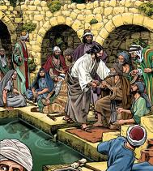
Vs. 7 The sick man said, “Sir, when the water is stirred, I don’t have anybody to put me in the pool. By the time I get there, somebody else is already in.”
The first thing Jesus says to do is what the man could not do, what he had tried for 38 years to do.
I want to be healed, but I cannot
I’ve tried, I’ve done everything I know
I’ve given up
I have no hope
Everyday he was reminded how bitter life was for him.
Notes:
This man wanted healing. Notice his answer: "Sir, I have no man to put me into the pool when the water is troubled, and while I am going another steps down before me." {John 5:7 RSV} “I want to be healed, but I cannot. I've tried, I've done everything I know how. I want to get into that water, I want to be healed, but I lack the ability; I've no one to help me. I've given up. I have no hope."
Matthew only uses the verb faith 11 times, Mark 10 times (plus 4 more in the ending of chapt. 16), Luke uses it 9 times, so John’s use is remarkable. Faith for John takes men right out of themselves making them one with Christ.
Jesus invited this man to become one of a long list of faithful souls throughout the history of sin. “Jesus [gave] him no assurance of divine help. The man might have stopped to doubt, and lost his one chance of healing. But he believed Christ's word, and in acting upon it he received strength.” (DA 203.1)
Jesus does not say, "Try to build up faith in your mind. Try to fasten your thoughts on this or that." He tells them to do something: "Rise! Stand up!"… The moment the man's will agreed with the Lord's will the power was there. He knew he could stand, and he did. (Stedman)

Slide 10
Vs. 7 The sick man said, “Sir, when the water is stirred, I don’t have anybody to put me in the pool. By the time I get there, somebody else is already in.”
In the Gospel of John the verb faith (πιστεύω) is found 98 times, while the corresponding noun faith (πίστις) is completely absent.
Notes:
This man wanted healing. Notice his answer: "Sir, I have no man to put me into the pool when the water is troubled, and while I am going another steps down before me." {John 5:7 RSV} “I want to be healed, but I cannot. I've tried, I've done everything I know how. I want to get into that water, I want to be healed, but I lack the ability; I've no one to help me. I've given up. I have no hope."
Matthew only uses the verb faith 11 times, Mark 10 times (plus 4 more in the ending of chapt. 16), Luke uses it 9 times, so John’s use is remarkable. Faith for John takes men right out of themselves making them one with Christ.
Jesus invited this man to become one of a long list of faithful souls throughout the history of sin. “Jesus [gave] him no assurance of divine help. The man might have stopped to doubt, and lost his one chance of healing. But he believed Christ's word, and in acting upon it he received strength.” (DA 203.1)
Jesus does not say, "Try to build up faith in your mind. Try to fasten your thoughts on this or that." He tells them to do something: "Rise! Stand up!"… The moment the man's will agreed with the Lord's will the power was there. He knew he could stand, and he did. (Stedman)

Slide 11
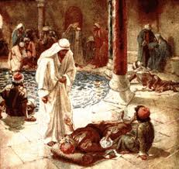
Vss. 8–9 Jesus said, “Get up, take your bedroll, start walking.” The man was healed on the spot. He picked up his bedroll and walked off.
What does Jesus do?
A pep talk?
Encouragement?
No!
He doesn’t ask him to exercise faith
He gives him no assurance of divine help
He asks him to walk!
As he acted upon it he received strength
For John, faith takes men right out of themselves and makes them one with Christ
Notes:
“Jesus does not ask this sufferer to exercise faith in Him.” (DA 202.3)
Jesus invited this man to become one of a long list of faithful souls throughout the history of sin. “Jesus [gave] him no assurance of divine help. The man might have stopped to doubt, and lost his one chance of healing. But he believed Christ's word, and in acting upon it he received strength.” (DA 203.1)
“the man's faith takes hold upon that word. Every nerve and muscle thrills with new life, and healthful action comes to his crippled limbs. Without question he sets his will to obey the command of Christ, and all his muscles respond to his will. Springing to his feet, he finds himself an active man.” (DA 202.3)
Jesus wants us to live the impossible
This man did what his religious leaders wouldn’t. He listened to the words of Jesus and acted upon them, no matter how impossible or ridiculous those words sounded.
Sin severs us from the life of God. Our souls are palsied (DA 203.2. Rather than being filled with the spirit, and empowered to live beyond limitations, we stay on familiar ground. Wanting desperately to believe God is okay with that
“The restored paralytic stooped to take up his bed, which was only a rug and a blanket, and as he straightened himself again with a sense of delight, he looked around for his Deliverer; but Jesus was lost in the crowd. The man feared that he would not know Him if he should see Him again.” (DA 203.3)
Why does the report say “he took up his pallet and walked.”? G. Campbell Morgan suggests that it was "In order to make no provision for a relapse." The man might have said to himself, "I'm healed, but I had better leave my bed here; I may need it tomorrow." If he had said that he would have been back in it the next day. But he did not. Jesus said, "Take up your bed. Get rid of it; don't leave it there." Jesus’ words remove the possibility of relapse, expecting continued success. (Stedman)

Slide 12
Mary Lemke
Asked to care for 6 mos. old Leslie abandoned by his parents until he died
mentally retarded
eyes removed
cerebral palsy (limp)
Totally unresponsive to sound or touch
Mary:
4 ½ ft. tall
already raised five children
52 yrs. old
weighed just 90 lbs.
a powerful believing Christian
refusing to consider him a burden
Her reply: “If I take him he certainly will not die, and I will take him.”

Slide 13
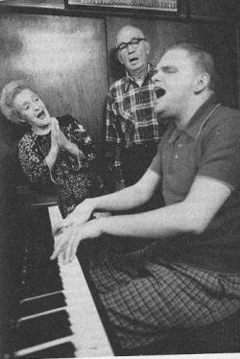
Mary Lemke
She taught him to suck, by putting the nipple between his lips and then her lips near his, moving the nipple and making sucking sounds
She bathed, cuddled him for hours, talking and singing. She massaged his body, put his hands next to her cheeks when she cried so he could feel her tears. Never a response
not a movement, smile, tear, sound.
if he didn’t tie him to he chair he would have toppled over
never reluctant to bring him out in public, he was her boy, her love. She was proud of him.
When asked why she didn’t institutionalize him, you’re wasting your time…
she snapped: “It’s you who’s wasting your time.”
“this kind of a child is brought around by kindness and love. Not in an hour or month or year. Lasting kindness”
In her prayers she pleaded for a miracle
Slowly he learned how to hold himself up and inch along a chain link fence
Once Mary noticed him snapping his fingers against a string, and bought a piano
After 19 years of loving
one night they awoke to music – leslie had left his bed and was perfectly playing the piano
next he was sing as he played
then he began giving concerts and walking

Slide 14
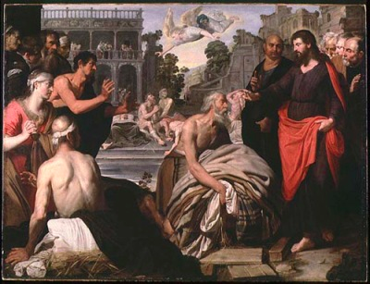
Vss ^{9–10} That day happened to be the Sabbath. The Jews stopped the healed man and said, “It’s the Sabbath. You can’t carry your bedroll around, it’s against the rules.”
Now the problems begin…
Jeremiah 17:21-25: “Thus saith the LORD; Take heed to yourselves, and bear no burden on the sabbath day, nor bring it in by the gates of Jerusalem; ²² Neither carry forth a burden out of your houses on the sabbath day, neither do ye any work, but hallow ye the sabbath day, as I commanded your fathers. ²³ But they obeyed not, neither inclined their ear, but made their neck stiff, that they might not hear, nor receive instruction. ²⁴ And it shall come to pass, if ye diligently hearken unto me, saith the LORD, to bring in no burden through the gates of this city on the sabbath day, but hallow the sabbath day, to do no work therein; ²⁵ Then shall there enter into the gates of this city kings and princes sitting upon the throne of David, riding in chariots and on horses, they, and their princes, the men of Judah, and the inhabitants of Jerusalem: and this city shall remain for ever.” (see also Neh. 13:15-19)
Notes:
“In his joy the man had forgotten that it was the Sabbath; yet he felt no condemnation for obeying the command of One who had such power from God. He answered boldly, "He that made me whole, the same said unto me, Take up thy bed, and walk." They asked who it was that had done this, but he could not tell. These rulers knew well that only One had shown Himself able to perform this miracle; but they wished for direct proof that it was Jesus, that they might condemn Him as a Sabbath-breaker. In their judgment He had not only broken the law in healing the sick man on the Sabbath, but had committed sacrilege in bidding him bear away his bed.” (DA 203.4)
When the religious leaders asked the healed man, “What man is that which said unto thee, Take up thy bed, and walk?” (5:12) He honestly didn’t know (vs. 13) for Jesus had left immediately after healing him.
“As he hurried on his way with firm, free step, praising God and rejoicing in his new-found strength, he met several of the Pharisees, and immediately told them of his cure.
“With lowering brows they interrupted him, asking why he was carrying his bed on the Sabbath day. They sternly reminded him that it was not lawful to bear burdens on the Lord's day.” (DA 203.4)
Jesus constantly confronted the religious leaders regarding their negative, hairsplitting regulations that served effectively to obscure the true purpose of the Sabbath. Such rules made the Sabbath an end in itself, binding men in slavery to it. This rigid Sabbath observance was at high tide during the Lord’s earthly ministry, and at no point did Jesus come into sharper conflict with the leaders of Judaism than on this matter (provoked by their extreme attitudes on this subject). Clearly this story of a Sabbath violation is only a sample of many, a habitual patter for Jesus, because they are all in the imperfect tense (describing repeated action in past time). Barclay, ibid, p 183

Slide 15
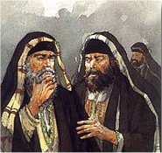
Sabbath rules…
The issue was trading on the Sabbath. The Rabbis argued a carrying a burden included:
if a needle was in his robe on the Sabbath
if artificial teeth or his wooden leg was used
any kind of brooch
This was a matter of life and death.
Forbidden on the Sabbath were:
writing as much as 2 letters of the alphabet or erasing in order to make space for 2 letters
lighting a fire or putting one out, however a Gentile could be hired to light a candle or a fire on the Sabbath.
It was also counted as Sabbath-breaking to look into a mirror fixed on the wall
An egg laid on the Sabbath might be sold to a Gentile, but not eaten
It was counted unlawful to expectorate upon the ground lest thereby a blade of grass be irrigated.
One could not carry a handkerchief on the Sabbath unless one end of it be sewed to one’s garment—in which case it was no longer technically a handkerchief but a part of the garment.

Slide 16
Why create the Problem?
He could have healed the paralytic on another day than the Sabbath.
He could have simply cured him without bidding him to bear his rug and blanket.
He intentionally performed seven of His healings upon the Sabbath day (Mk 1:21–31; 3:1–5; Lk 13:10–17; 14:1–4; Jn 5:1–15; 9:1–7)
to confront the foolishness and wrongness of their teachings which instead of drawing people to God made God into a heartless tyrant.
He wanted to present the Sabbath it its true light instead of binding it with foolish non-sensical rules.
“He had come to free the Sabbath from those burdensome requirements that had made it a curse instead of a blessing.” (DA 206.1)
Notes:
See DA 203.3; 206.2
That is the reason why, of all those gathered at the pool, Jesus selected just one to heal – to force this debate. He selected the worst case there to cause people to question what was lawful on the Sabbath, to challenge the Pharisaical restrictions. (see DA 206.2)

Slide 17
Vs. ¹¹ But he told them, “The man who made me well told me to. He said, ‘Take your bedroll and start walking.’ ”

Slide 18
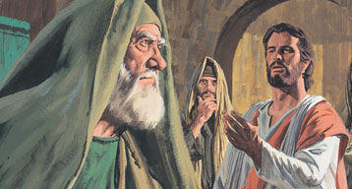
Why the betrayal?
Afterwards
Jesus found him in the temple (vs. 14)
Then the man returned to the religious leaders to tell them it was Jesus who had made him whole. (vs. 15)
He wasn’t trying to betray Jesus
he was simply trying to explain that it wasn’t his fault that he had broken the law (that’s how oppressive the Sabbath rules were – to cause this honest man to betray his healer, for fear of coming under their wrath).
The healed paralytic had no idea the intrigue, plotting and scheming going on within the Jewish leaders regarding Jesus.
He simply “was surprised at the coldness with which they listened to his story.” (DA 203.3)
A Spiritual Problem:
“And the light shineth in darkness; and the darkness comprehended it not.” (Jn. 1:5)
“He was in the world, and the world was made by him, and the world knew him not. He came unto his own, and his own received him not.” (Jn. 1:10, 11)
Notes:
The paralytic would be the first, outside of Jesus himself, to feel their escalating wrath.

Slide 19
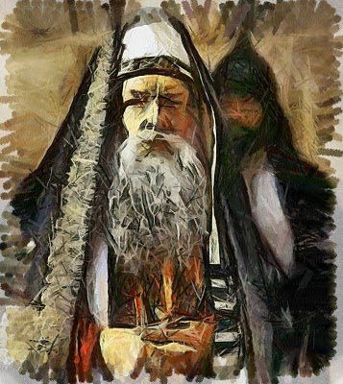
The Solution
“But as many as received him, to them gave he power to become the sons of God, [even] to them that believe on his name: Which were born, not of blood, nor of the will of the flesh, nor of the will of man, but of God.” (Jn. 1:12, 13)
God welcomes questioning hearts
But cannot do a thing with closed hearts!
Notes:
“Had the rabbis felt any desire to receive light, they would have been convinced that Jesus spoke the truth.” (DA 208.1)
while claiming faithfulness to God they were getting their directions from Satan (see DA 205, 206).
“The fury of the rulers knew no bounds. Had they not feared the people, the priests and rabbis would have slain Jesus on the spot.” (DA 208.1) Jesus’ popularity came partly because the people knew him as their friend, who healed their diseases and comforted their sorrows. (DA 208.1) So shall it be with us today. Decisions about us are based upon how well we care for and about others, whether we are true friends. It is the same now as then.

Slide 20
Jesus’ defense before the Pharisees
“My Father worketh hitherto, and I work.” (vs. 17).
God doesn’t stop his work on the Sabbath
It is a day of blessing… making our lives richer, fuller
Therefore we should do our most to help people on Sabbath
Other work may be laid aside but not the work of compassion
“Verily, verily” #1:
Be certain to pay attention to this…
“The Son can do nothing of himself, but what he seeth the Father do: for what things soever he doeth, these also doeth the Son likewise.” (vs. 19).
There is no greater duty than to relieve someone’s pain and distress
The follower of Christ must be like God

Slide 21
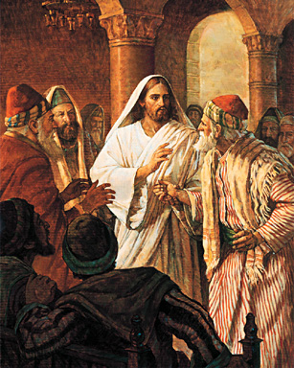
Jesus’ Defense:
“Verily, Verily” #2
“He that heareth my word, and believeth on him that sent me, hath everlasting life, and shall not come into condemnation; but is passed from death unto life.” 5:24
The OT makes it clear that life derives from the Father.
He breathes life into men (Gen. 2:7)
It’s a gift from him (Job 10:12; 33:4)
He “is the fountain of life” (Ps. 36:9)
Shows men “the path of life” (Ps. 16:11)
“holdeth our soul in life” (Ps. 66:9)
Moses went so far as o say “he is thy life” (Deut. 30:20)
The Psalmist speaks similarly, “Jehovah is the strength of my life” (Ps. 27:1)
In the OT God alone can raise the dead and alone has the right to judge. “I, even I, am he and there is no god beside me: I kill and I make alive” (Deut. 2:39; see also 1 Sam. 2:6; 2 Ki. 5:6).

Slide 22
Jesus’ Defense:
“Verily, Verily” #3
“Verily, verily, I say unto you, The hour is coming, and now is, when the dead shall hear the voice of the Son of God: and they that hear shall live.” Jn. 5:25
“As the Father raiseth up the dead, and quickeneth them; even so the Son quickeneth whom He will.” John 5:21
The Sadducees (priests) dismissed this outright – to them there could be no resurrection.
But the Pharisees did believe in the resurrection.
Dead bodies (paralytic) can come to life
Spiritually dead people can be revived, those who:
have stopped trying
have stopped feeling
have stopped thinking
Notes:
The spiritually dead are those who have stopped trying. They look on all faults as ineradicable and all virtues as unattainable. They have also stopped feeling, becoming desensitized to evil, sorrow and suffering, feeling no grief and pity. When compassion (our ability to feel) goes the heart is dead. The trio is completed when thinking stops; the desire to learn leaves, new truth, new methods, new thought become simply a disturbance which we cannot bear, that is the day we die spiritually. To be spiritually dead is to have stopped repenting, so we can sin in peace. To avoid spiritual death we must keep sensitive to sin by keeping sensitive to the presence of Jesus.

Slide 23
Jesus’ Defense:
“For the Father judgeth no man, but hath committed all judgment unto the Son” Jn. 5:22
In the OT judgment was so typically of God that He was spoken of as “the Judge of all the earth” (Gen. 18:25), The final verdict is always his.
Granting to the Son the power of judgment would appear to the Jews not only impossible but blasphemy.
Later Jewish thought allowed the Son of Man to act as judge when bringing in the new age of God.
Enoch says of the Son of Man: “The sum of judgment was committed to him.” (Enoch 69:26, 27)
This term has a long and cherished history. It was born in Daniel 7:1-14
in a vision of a time of horrible terror and persecution when people were dominated by kingdoms that could only be described as beastly cruel. So savage they couldn’t be represented as human.
At the height of their cruelty appears a phenomenon to stand up for the saints against the cruelty and savageness of their rulers.
Daniel calls their savior “the Son of man.” (Dan. 7:13) The Jews understood this as a prediction of the coming Messiah.
Notes:
“He who opens his heart to the Spirit of Christ becomes a partaker of that mighty power which shall bring forth his body from the grave.” (DA 209.3)
One scholar reported that Jewish historians counted no less than sixty-four messianic claimants in and around the 1st century AD. Between the Old and New Testaments there arose a whole literature which dealt with the golden age which was to come. Especially influential was the Book of Enoch where again and again a great figure called the Son of Man appears, who is waiting in heaven until God sends him to earth to usher in his kingdom and rule over it.

Slide 24
Jesus’ Defense:
“For the Father judgeth no man, but hath committed all judgment unto the Son” Jn. 5:22
When Jesus called himself the Son of Man, he was doing nothing less than call himself the Messiah.
The very miracle to the paralyzed man was a sign that Jesus was the Messiah.
It was Isaiah’s picture of the new age of God that would usher in amazing changes so that “the lame man leap like a hart” (Isa. 35:6),
and Jeremiah’s vision of the blind and the lame be gathered in (Jeremiah 31:8,9).
This is Jesus’ favorite self-designation (John 1:51; 3:13,14; 5:27; 6:27,53, 62; 8:28; 9:35; 12:23, 34; 13:31), occurring over eighty times. A term nobody else has claimed or has been applied to themselves.
The martyr Stephen (Acts 7:56) recognized Jesus as the Son of man in his vision at his death. John’s aim in writing his Gospel was “that ye may believe that Jesus is the Christ, the Son of God” (20:31).

Slide 25
Jesus’ Defense:
Justice demands two or three witnesses (Deut. 19:15). So Jesus
presents his witnesses:
1) the Father 5:32, 37
Because Jesus has the witness of God He is not troubled
by their opposition.
they had never seen God’s form, but Israel saw it
(Gen. 32:30f) likewise they are not true Israelites. If they were, they would have seen God in Jesus (Jn. 14:9)
2) John the Baptist 5:33; 1:19, 20, 26; 29, 35, 36
3) Jesus’ works 5:36
The works that Jesus did are no ordinary works (15:24). They are the Father’s works, and, indeed, it is the Father abiding in Him who does them (14:10)
4) scripture 5:39
they have not God’s word abiding in them (Jn. 15:7) whereas the Psalmist laid up God’s word in his heart (Ps. 119:11), but not them, they laid up their word’s in their heart. If they had laid up God’s word they would have received the word of Jesus (Jn. 17:14).
5) Moses 5:46
Because they had never heard God’s voice (as Moses had Ex. 33:11) hence they are not true followers of Moses, otherwise they would have heard God’s voice in Jesus (Jn. 3:34; 17:8)
It is just as John had said in his prologue “He was in the world, and the world was made by him, and the world knew him not. He came unto his own, and his own received him not.” (John 1;10, 11)
Notes:
see also Dt. 17:6; 2 Cor. 13:1; Matthew 18:16; 1 Tim. 5:19. Rabbinic sayings in Ket. 2:9 say “none may be believed when he testifies of himself… None may testify of himself” in Morris, p. 24, footnote 91. The Mishnah said: “A man is not worthy of belief when he is speaking about himself.” Ancient law knew that self-interest had an effect on a man’s statements about himself. Morris, p. 328
“He who opens his heart to the Spirit of Christ becomes a partaker of that mighty power which shall bring forth his body from the grave.” (DA 209.3)
One scholar reported that Jewish historians counted no less than sixty-four messianic claimants in and around the 1st century AD. Between the Old and New Testaments there arose a whole literature which dealt with the golden age which was to come. Especially influential was the Book of Enoch where again and again a great figure called the Son of Man appears, who is waiting in heaven until God sends him to earth to usher in his kingdom and rule over it.

Slide 26
“Take up thy bed and walk”

Slide 27
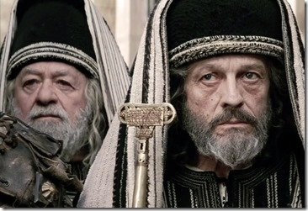
vvv

Slide 28
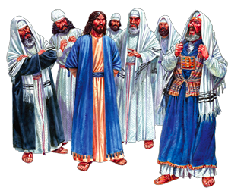
www

Slide 29
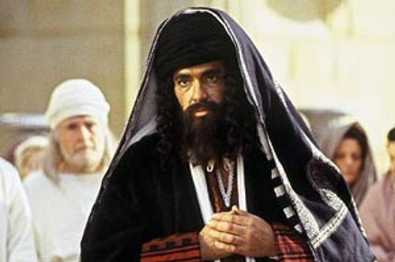
www

Slide 30
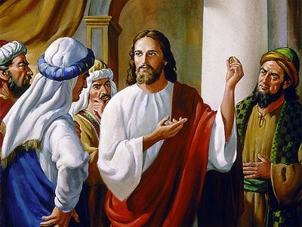
www

Slide 31
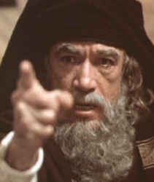
www

