Slide 1
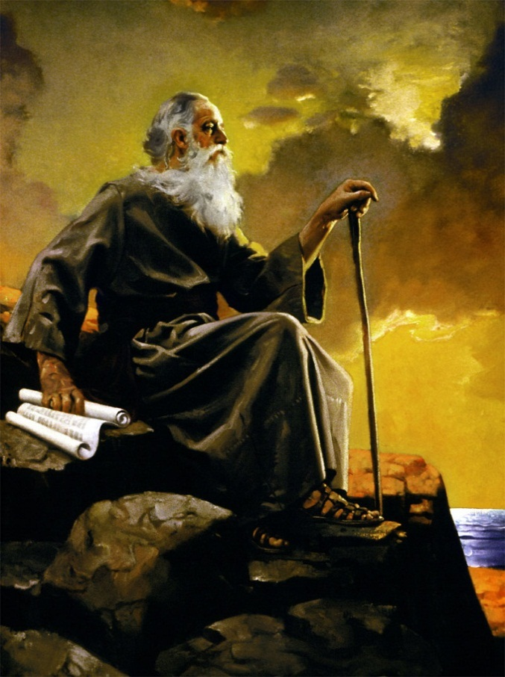
“Replacing the Old with the New”
John Series #3
Fort Bragg, Mar. 9, 2013

Slide 2
How to Read John…
John purpose for writing:
That we might believe (20:31)
He intentionally picks and chooses His content
Our job is to understand why (or we miss his point)
John is not about:
Oratory
Prophecy
Mystery
Knowledge
Generosity
Self Sacrifice
John is about Love…
Stop…
Compare…
Learn…

Slide 3
Timing:
(4-5 BC) Birth
(to 27 AD) Infancy to Manhood of Jesus
(27 AD) Ministry of John the Baptist
Matt. 3:1-12; Mark 1:1-8; Luke 3:1-18; John 1:15-28
John’s confession and Baptism of Jesus
Matt. 3:13-17; Mark 1:9-11; Luke 3:21,22; John 1:29-34
Jesus’ Temptation in Wilderness
Matt. 4:1-11; Mark. 1:9-11; Luke 4:1-13
John’s prologue
John 1:1-14
Jesus is declared to be “The Lamb of God”
John 1:19-34
The calling of the first disciples
John 1:35-51
The 1st Miracle: Wedding Feast at Cana
John 2:1-12

Slide 4
Jesus fresh from battle with Satan:
40 days in the wilderness tested by Lucifer (without bread or water).
Victorious from battle with Satan, he
reappears to John the Baptist at the Jordan …
is affirmed again by John …
calls his disciples …
launches his ministry…
in respect for his mother appears with his disciples in Cana for a wedding.

Slide 5
Wedding at Cana (autumn AD 27)
Jesus was now at least 30 years of age (a requirement to be a Rabbi) ready to begin his ministry.
If the wedding at Cana happened (as Jewish custom) on Wednesday (Ketuboth 1:1; see also Danby, 245).
The apostle John’s first contact with Jesus was on Sabbath (3 days earlier John 2:1)
How perfect to keep the Sabbath in the presence of our Creator:
blessed, rested, sanctified – Gen. 2:1-3.
Riding upon the high places of the earth – feed thee with the heritage of Jacob (Isa. 58:14)
dwell together as one…

Slide 6
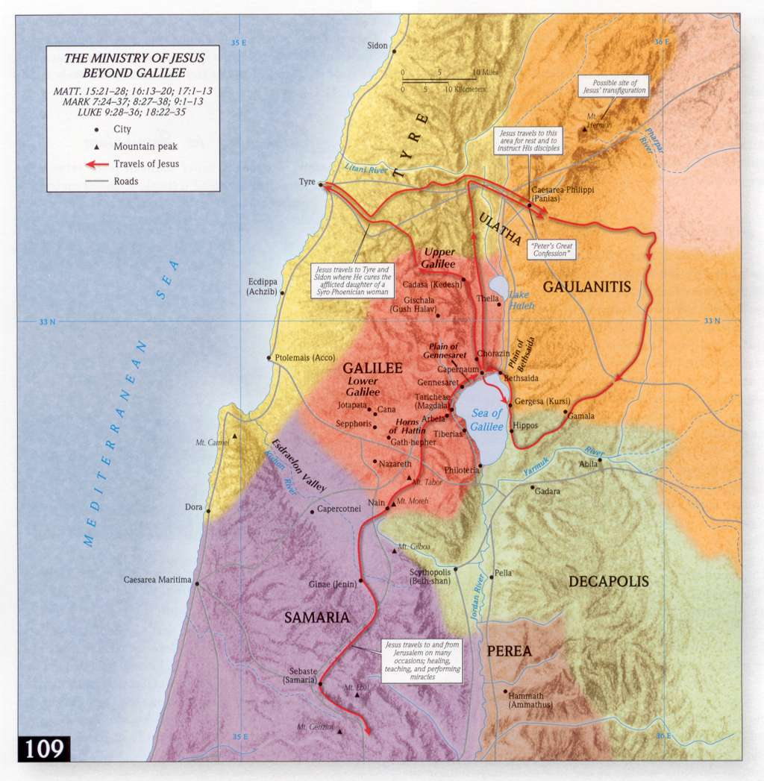

Slide 7
John 2:1-11:
1 And the third day there was a marriage in Cana of Galilee; and the mother of Jesus was there:
2 And both Jesus was called, and his disciples, to the marriage.
3 And when they wanted wine, the mother of Jesus saith unto him, They have no wine.
4 Jesus saith unto her, Woman, what have I to do with thee? mine hour is not yet come.
5 His mother saith unto the servants, Whatsoever he saith unto you, do [it].
6 And there were set there six waterpots of stone, after the manner of the purifying of the Jews, containing two or three firkins apiece.
7 Jesus saith unto them, Fill the waterpots with water. And they filled them up to the brim.
8 And he saith unto them, Draw out now, and bear unto the governor of the feast. And they bare [it].
9 When the ruler of the feast had tasted the water that was made wine, and knew not whence it was: (but the servants which drew the water knew;) the governor of the feast called the bridegroom,
10 And saith unto him, Every man at the beginning doth set forth good wine; and when men have well drunk, then that which is worse: [but] thou hast kept the good wine until now.
11 This beginning of miracles did Jesus in Cana of Galilee, and manifested forth his glory; and his disciples believed on him.”

Slide 8
The Wedding:
A third-century tradition held that John, the beloved disciple, was the son of Salome (Mary’s sister). If this was so, John and Jesus were first cousins.
Some scholars have thought this wedding might have been the wedding of the apostle John or a relative of his (Brown, 1:98, in Jon Paulien, p. 70)
Whatever the case, Mary’s roll at this wedding corresponded to that of a matron of honor
Charged with helping cater the feast.
The shortage of wine would be her personal responsibility.
If however, the wine was dependent on the generosity of guests
Her comment might be a slight rebuke to Jesus and his team of disciples for not bringing their share of wine.

Slide 9
Mary: knowing…
all that had recently happened about her son
aware that he was the age to begin his ministry
remembering all she treasured in her heart about him from the time of his conception till now
perhaps she too was pushing him to reveal himself by doing something wonderful (meaning of “miracle”)
But his hour had not yet come (2:4) He knows he cannot win people’s hearts by “signs,” in fact they in some ways hindered his ministry
His mother says to her helpers “Whatsoever he saith unto you, do [it].” (2:5)

Slide 10
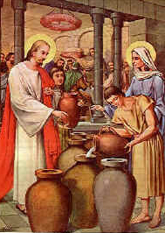
Jesus turns Water into Wine:
“And there were set there six waterpots of stone, after the manner of the purifying of the Jews, containing two or three firkins apiece. Jesus saith unto them, Fill the waterpots with water. And they filled them up to the brim. And he saith unto them,
Draw out now, and bear unto the governor of the feast. And they bare [it].” (2:6-8)
these 20-30 gallon pots of waters required
for ritual purification (2:6) were unusually
large. Their purpose was primarily for
cleansing.
Why does John start with this story?
What is it saying about Jesus that
makes it a perfect beginning point?

Slide 11
John’s Outline:
First Miracle at Cana (2:1-11)
B. Temple in Jerusalem (vss. 12-25)
C. Discourse with Nicodemus (3:1-21)
D. The Baptist (vss. 22:3)
D. Jesus (vss. 31-36)
C. Discourse with the Samaritan woman
(4:1-42)
B. Events in Jerusalem (vss. 43-45)
A. Second miracle at Cana (vss. 46-54)

Slide 12
Water: Symbolic of Transition…
Moses turned water into blood in preparation for his people being allowed to escape Egypt (Exod. 7:14-24)
When leaving Egypt he separated the waters at the reed sea
During their dessert wandering water from Rock indicated they were under God’s providence
Crossing of Jordan symbolized they were now at home, in their own land
Baptism means we have become part of Christ’s Family. Inheriting all rights, privileges and responsibilities

Slide 13
Water: Symbolic of Transition…
As a servant Elisha poured water over Elijah, his master’s hands
When the time came for passing the mantel from Elijah to Elisha
Elijah threw his cloak upon the Jordan and it separated allowing both to pass
Elijah was transported to heaven
Elisha returned to the Jordan and using Elijah’s cloak likewise threw it down upon the Jordan and again it parted allowing him to pass over
The son’s of the prophets, witnessing it took this as evidence that the spirit of Elijah resided in Elisha (2 Ki. 2)

Slide 14
Water Miracles = God was present…
The men of Jericho complained that their water was barren, asked Elisha to make it good. He poured a cruse of salt into the water and it became good (2 Ki. 2:19-22)
Later, when the kings of Judah, Israel, & Edom united against Moab, the found themselves, their warriors and livestock, in the dessert without any water
They came to Elisha asking for help, he told them to start digging ditches, telling them that without wind or rain, the ditches would fill with water
When the Moabites saw it, it appeared to them as blood (2 Ki. 3) – the water/blood biblical theme

Slide 15
The First Miracle “sign”
indicating the arrival of a new age with its attending miracles
John lists 7 of these signs, designed to alert us “things were changing”:
Water into Wine (2:1-11)
Official son healed (4:46-54)
Sick man at pool of Bethesda (5:2-9ff)
Feeding the 5,000 (6:1-15ff)
Walking on Water (6:16-21)
Healing a man born blind (9:1-39)
Raising Lazarus from death (11:38-44)

Slide 16
Parallels between Moses & Jesus:
Like Moses  Jesus is threatened at birth by a hostile king who kills all the babies but the one he really wants to destroy (Matt. 2:16-18)
Like Moses  Jesus sees God (John 1:17, 18)
Like Moses  Jesus fasted for 40 days (Matt. 4:2; Luke 4:2
Like Moses  Jesus appointed 70 disciples (Luke 10:1)
Like Moses  Jesus has 12 apostles (Matt. 10:1-4; Mark 3:13-19; Luke 6:12-16)
Like Moses  Jesus gave a new law from a mountain (Matt. 5-7)
Like Moses  Jesus fed a multitude in the desert (Matt. 14:13-21; Mark 6:3-44; Luke 9:10-17; John 6:1-15)
Like Moses  Jesus was raised upon a cross as Moses lifted the serpent on his staff in the wilderness (Jn. 3:14)
Like Moses  Jesus came out of Egypt (Matt. 2:13-15, 19-23) just as Moses and the Israelites did

Slide 17
More Parallels between Jesus & Moses
Jn. 1:17 – law came via Moses; truth via Jesus
Jn. 3:14 – Moses lifted up serpent; Jesus lifted up
Jn. 5:45-47 – if you would have believed Moses you would have believed me
Jn. 6:30-33 – Moses gave bread from heaven – I am that bread
Jn. 9:28,29 – Jews acknowledged God spoke through Moses, but refused to do the same for Jesus

Slide 18
The Theme is Replacement
A new Moses had arrived  one far greater than him
Refusal to accept Jesus, made the Jews in Jesus’ day into their own enemies  They had become Pharaoh and the Egyptians to the Jews (enslaving and killing them)
Greatest example of this was AD 70.
When Herod began rebuilding the Jewish Temple in 19 BC. It wasn’t completed until 63 AD (an 82 yr. project)
Just 7 yrs. later, because of their allowing radical Judaism free expression, Rome took reined them in. Continued stubborn resistance ended in Rome putting the Temple to the torch. In the end over a million died

Slide 19
A Stubborn and Headstrong People:
Nobody makes this case stronger than John…
They simply would not hear (allow) any of it…
Sadly, John states:
“He was in the world, and the world was made by him, and the world knew him not. He came unto his own, and his own received him not.” (John 1:10,11)
They had no comprehension of spiritual things (3:10; 8:15, 38, 43; 10;1-6)
Only the Holy Ghost teacheth by comparing spiritual things with spiritual. (1 Cor. 2:13)
They would find themselves in utter darkness…

Slide 20
A deplorable situation:
The Temple had become a feed lot filled with profiteering for the Priestly class
Started during reign of Caiaphas (A.D. 18-36 see Bruce, New Testament History, (1972) 64, 65
Their only passion now was political security for themselves
The Pharisees had become angry zealots
Majoring on the insignificant
The Essenes had fled to the dessert to create a holy compound
No one was compassionate, spiritual, or noble

Slide 21
The Old had worn out, it was barren
It’s Barrenness, represented by:
Nicodemus (chapt. 3)
The Samaritan woman (chapt. 4)
Life without a son (Nobleman) (chapt. 4)
38 yrs. of being paralyzed (chapt. 5)
Generations of clinging to dead forms (Jn. 5, 7)
A life apart from Jesus (Jn. 5)
Never knowing where your next meal will come from (John 6)
Life when you’re about to loose it (Jn. 6)
Being engulfed in Sin – Mary (Jn.8:3-11; 12:1-8)

Slide 22
For John, it’s all about Jesus…
There is no other way to be saved but by absorbing Jesus into your soul…
Faith, in John, is always expressed as a verb
For Paul, faith was a noun…
“Verily, verily, I say unto you, Except a corn of wheat fall into the ground and die, it abideth alone: but if it die, it bringeth forth much fruit. He that loveth his life shall lose it; and he that hateth his life in this world shall keep it unto life eternal.” (12:24-25)
“Except a man be born again, he cannot see the kingdom of God.” (3:3)
never was there a man who spoke like Jesus (7:46)

