Slide 1
My Goals for 2013
Personal:
Spend more quality time in each church
Spend more quality time with my family
Carefully manage/control my calendar
Church:
Support Child/Youth ministry
Keep Church Finances in order
Launch long-term evangelism plans
Prepare for Centennial
Study the Gospel of John

Slide 2
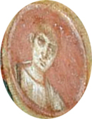
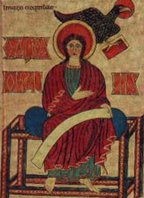
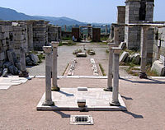
The Gospel according to John
Fort Bragg, 1-26-2013

Slide 3
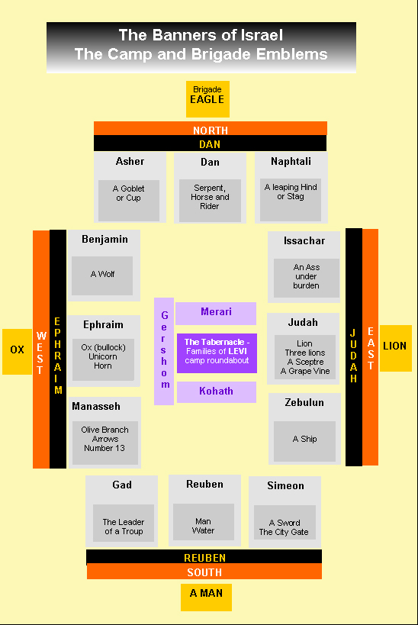
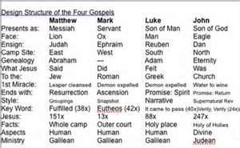
Uniqueness of each Gospel
Gospels depicted as: (Ezek. 1:10; Rev. 4:7)
Matthew – lion (Messiah/Judah)
Mark – ox (plainest/human)
Luke – man (service/sacrifice)
John - eagle (heights/big picture)
Notes:
Mark represented by a man, Matthew by a lion, Luke an ox, and John an eagle. Why an eagle for John. Because an eagle alone can look straight into the sun and not be dazzled. And John alone penetrates most deeply into the eternal mysteries of God, soaring higher than the rest.
It was Augustine who matched:
Mark with a man, who gives us the most human picture of Jesus;
the lion stood for Matthew, who shows us Jesus as the Messiah, the lion of Judah;
the ox stood for Luke, for the ox is the animal of sacrifice, and Luke shows us Jesus as the sacrifice and the Saviour for the sins of the world;
and the eagle stood for John, "because John took a higher flight, and soared in his preaching much more sublimely than the other three"
(Homilies on John, 36).
It is said that only the eagle of all living creatures can look straight into the sun; so John looks more directly into the blaze of divine truth than any other of the Gospel writers.

Slide 4
John see’s a different Jesus:
Jesus behaves differently:
He is not the “lowly Jesus, meek and mild” of the synoptics. Instead he is:
Assertive (2:4; 4:17, 18, 48; 5:45-47; 7:6-9)
Combative (3:10-12; 5:39,40,42; 8:44)
More engaged in the rough and tumble of debate (3:1-15; 8:31-47)
Even a bit sarcastic at times (9:41; 10:32)
What’s the good news about this to John, a “son of thunder” (Mark 3:17)
Notes:
John, son of thunder (Mark 3:17) was so complex, capable of such depth that those close to Him could portray Him in radically different ways, while still being true to fact.
The mild, always gentle, phlegmatic personality, that everyone today assumes Jesus had, is not always the case.

Slide 5
How Jesus interacts with people:
Lengthy one-on-one encounters:
Nicodemus (3:1-21)
The Samaritan woman (4:4-42)
The paralytic at Bethesda (5:1-15)
The blind man (9:1-41)
Pilate (18:28-19:16)
Peter (21:15-23)
Offering deeper insights into what is going on inside them

Slide 6
What John doesn’t include:
No parables:
Closest John comes are allegories:
The Good Shepherd (10:1-18)
The True Vine (15:1-8)
Many important accounts in the synoptics are omitted:
His birth, baptism, temptations, Last Supper, Gethsemane, and ascension
Healings, possession by evil spirits

Slide 7
John is careful about precise details:
Recording exact information about:
The location of Jacob’s well (4:4-6)
Accurate knowledge of Jerusalem and its environs
Solomon’s Colonnade (10:23)
The layout of the Pool of Bethesda (5:2 – destroyed for over 25 yrs. when John wrote)
The number, size, an weight of the water pots at the wedding in Cana (2:6)
Soldiers gambling over Jesus’ garment (19:23, 24)

Slide 8
Jesus’ methods are different:
The other gospels reveal a tactile Jesus who repeatedly touched people when healing them: (Matt. 8:3,4,14,15; 9:18-25,29,30; 14:29-31; 20:34; Mark 1:29-31,40-42; 5:21-43; 7:31-35; 8:22-26; 9:25-27; Luke 4:40; 5:12,13; 7:14,15; 8:40-56; 13:13; 22:51)
In John, Jesus’ miracles require an act of faith on the part of the recipient…
Cana – “Fill” and “Draw” water was needed
Royal Official must “go”
Paralytic must “get up”
Lazarus must “Come out!”
Notes:
The generation that knew Jesus personally were gone or almost gone. John was clearly the link to a generation that would believe not because they saw first hand, but because they believed through the word of those who did, i.e. Thomas (20:29). The disciples were the branches connected to the vine (Jesus), and the converts of the disciples were the fruit. The lack of a living apostle should be no barrier to their Christian life.

Slide 9
John’s audience is different:
Those not having first hand experienced Jesus:
Those who hadn’t seen but believed through the word (20:29).
The power of Jesus’ presence is replaced with active faith in his word:
Wedding in Cana (2:1-11) “whatever he saith, do it”
Royal official’s son in Capernaum (4:46-54) was 16 miles away
The Paralytic at Bethesda (5:1-15) rise & walk
Blind man (9) had to go more than a kilometer away to wash to complete the healing & then defend it
Lazarus (11) delayed for the benefit of Mary & Martha
Notes:
The generation that knew Jesus personally were gone or almost gone. John was clearly the link to a generation that would believe not because they saw first hand, but because they believed through the word of those who did, i.e. Thomas (20:29). The disciples were the branches connected to the vine (Jesus), and the converts of the disciples were the fruit. The lack of a living apostle should be no barrier to their Christian life.

Slide 10
Jesus is literally “God with us”:
Without John’s prologue many of the statements he makes afterward would seem ridiculous.
The OT logos is not a teaching but a person, like us!
No room for gnostic or docetist theories
We can be like him! (Gen. 1:26; Ps. 17:5; Rom. 8:3f; Phil. 2:7-11; Heb. 2:17; 12:2; 1 Jn. 3:2)
The WORD is LIFE (1:4, 14; 3:11-17; 5:24-26; 12:23-25; 1 John 1:1)
Bread is living (6:35, 51)
Body is resurrected (11:25)
There is a new “way, truth, life” (14:6)
Life has become Abundant (10:10; 6:63, 68)
Now, not in the Future!

Slide 11
John places great value on the Spirit:
To Nicodemus: “Except a man be born of water and [of] the Spirit, he cannot enter into the kingdom of God.” (3:5)
To the Woman at the Well: “the hour cometh, and now is, when the true worshippers shall worship the Father in spirit and in truth: for the Father seeketh such to worship him. God [is] a Spirit: and they that worship him must worship [him] in spirit and in truth.” (4:23,24)
When his disciples doubted, he said: “It is the spirit that quickeneth; the flesh profiteth nothing: the words that I speak unto you, [they] are spirit, and [they] are life.” (6:63)

Slide 12
The Holy Spirit is key to our success
Holy Spirit facilitates all of Jesus’ wishes (16:7)
To His Disciples: “I will pray the Father, and he shall give you another Comforter, that he may abide with you for ever; [Even] the Spirit of truth; whom the world cannot receive, because it seeth him not, neither knoweth him: but ye know him; for he dwelleth with you, and shall be in you. I will not leave you comfortless: I will come to you.” (14:16-18)
We can be as close to God as Jesus was
It’s not about us, it’s about God!
Victory is not from without but within (Col. 1:27)

Slide 13
The end of Zionism:
Synoptics: Focus was on the kingdom of God (Matt. 12:28; Mark 10:15; Luke 12:31; 17:20, 21)
In John’s day Zionism was already dying
65 yrs. after the destruction of their temple in AD 70, Jews were displaced throughout the middle east
A new Zionist movement headed by bar Kochba to rebuild the temple and restore Palestine to the Jews
Rome crushed the rebellion forever making Jerusalem off-limit to Jews except for the annual anniversary of the Temple’s destruction
Between AD 70-135, almost 2.5 million Jews were slaughtered, starved to death or sold as slaves
Thereafter only occasionally did they venture back to their homeland

Slide 14
What was ahead…
Persecutions: expanding from Jewish to Christian
Between AD 30-311 about a dozen emperors persecuted Christians.
AD 64-68 – Nero (martyrdom of Peter & Paul)
AD 81-96 – Domitian
AD 112-117 – Trajan (Christianity outlawed)
AD 161-180 – Marcus Aurelius (martyrdom of Polycarp)
AD 202-210 – Septimus Severus ( “ of Perpetua)
AD 250-251 – Decius (Xians sought/sacrifice required)
AD 257-259 – Valerian
AD 235-238 – Maximinus the Thracian
AD 270-275 – Aurelian
AD 303-324 – Diocletian and Galerius (Severe)
Notes:
Roman historian Tacitus: “Besides being put to death they [the Christians] were made to serve as objects of amusement; they were clad in the hides of beast and torn to death by dogs; others were crucified, others set on fire to serve to illuminate the night when daylight failed.”
In 112 AD, Roman governor Pliny the Younger was sent by the emperor Trajan (r. 98-117) to the province of Bithynia on official business. During his visit, Pliny encountered Christians, and he wrote to the emperor about them. The governor indicated that he had ordered the execution of several Christians, "for I held no question that whatever it was they admitted, in any case obstinancy and unbending perversity deserve to be punished." However, he was unsure what to do about those who said they were no longer Christians, and asked Trajan his advice. The emperor responded that Christians should not be sought out, anonymous tips should be rejected as "unworthy of our times," and if they recanted and "worshipped our gods," they were to be freed. Those who persisted, however, should be punished.
The persecution under Decius was the first universal and organized persecution of Christians, and it would have lasting significance for the Christian church. In January of 250, Decius issued an edict requiring all citizens to sacrifice to the emperor in the presence of a Roman official and obtain a certificate (libellus) proving they had done so. Forty-four of these libelli have survived. One surviving example reads:
To those appointed to see the sacrifices:
From Aurelia Charis of the Egyptian village of Theadelphia.
“I have always continued to sacrifice and show reverence to the gods, and now, in your presence, I have poured a libation and sacrificed and eaten some of the sacrificial meat. I request you to certify this for me below.”
This method of persecution created a crisis of conscience for many Christians, as a certificate could be obtained without actually sacrificing by bribing Roman officials. It was clear that Christians should not sacrifice to a false god, but whether it was acceptable to save one's life by buying a certificate was a bit more of a gray area. Many Christians chose to defy the edict outright, refusing to buy a certificate, and were arrested or executed. Among those martyred under Decius were the bishops of Rome, Jerusalem and Antioch. However, the bishop of Smyrna performed the sacrifice, as did many others.
In general, public opinion condemned the government's violence and admired the martyrs' passive resistance, and the Christian movement was thereby strengthened. The Decian persecution ceased in 251, a few months before Decius' death. The Decian persecution had lasting repurcussions for the church. How should those who had bought a certificate or actually sacrificed be treated? It seems that in most churches, those who had lapsed were accepted back into the fold, but some groups refused them admission to the church. This raised important issues about the nature of the church, forgiveness, and the high value of martyrdom. A century and a half later, St. Augustine would battle with an influential group called the Donatists, who broke away from the Catholic Church because the latter embraced the lapsed.
Under Valerian, who took the throne in 253, all Christian clergy were required to sacrifice to the gods. In a 257 edict, the punishment was exile; in 258, the punishment was death. Christian senators, knights and ladies were also required to sacrifice under pain of heavy fines, reduction of rank and, later, death. Finally, all Christians were forbidden to visit their cemeteries. Among those executed under Valerian were St. Cyprian, Bishop of Carthage, and Sixtus II, Bishop of Rome. According to a letter written by Dionysus during this time, "men and women, young and old, maidens and matrons, soldiers and civilians, of every age and race, some by scourging and fire, others by the sword, have conquered in the strife and won their crowns." The persecution ended with the capture of Valerian by Persia. Valerian's son and successor, Gallienus, revoked the edicts of his father.
The last major Roman persecution of Christians occurred under Diocletian, and it was the worst of all. It is known as the "Great Persecution." The reasons for this persecution are unclear, but Diocletians actions may have been based on the influence of his junior colleague Galarius (a fanatical adherent of Roman religion), Porphyry (an anti-Christian Neoplatonist philosopher), or the usual desire for political unity. In any case, Diocletian published four edicts of 303-04. The emperor ordered the burning of Christian books and churches, but promised not to spill any blood. In actuality, the Diocletian persecution turned out to be extremely violent. This violence "did not succeed in annihilating Christianity but caused the faith of the martyrs to blaze forth instead."
Official persecution of Christians ended with the Edict of Milan, signed by the Christian convert Constantine and his co-emperor Licinius. This did not make Christianity the official religion of the empire (that happened under Emperor Theodosius in 381), but granted it legal status.
http://www.religionfacts.com/christianity/history/persecution.htm

Slide 15
The Church lived even when dying…
Justin Martyr:
"Though beheaded, and crucified, and thrown to wild beasts, and chains, and fire, and all other kinds of torture, we do not give up our confession; but, the more such things happen, the more do others in larger numbers become faithful.“
Summary:
In the face of persecution, many Christians chose to die before they would deny their Lord. Those who did so came to be called martyrs, which means "witnesses."
The second-century theologian Tertullian had converted to Christianity based in part on his wonder at Christians' faithfulness in the face of martyrdom and it clearly had a similar effect on others as well. It was Tertullian who famously declared, "The blood of the martyrs is the seed of the church." Indeed, persecution seemed to have a dramatic effect on Christianity's numbers, but not in the direction intended by the persecutors.

Slide 16
Yet Zionism persistently hangs on:
Birth of modern Zionism:
A 35 yr. old Hungarian Jew, Theodor Herzl, in 1895 resurrected modern Zionism.
Due to the frenzy of hostile Jewish sentiment over the false conviction of a French Jew, Alfred Dreyfus, condemned to life imprisonment.
Immediately he sensed the loss of identity and homeland
Dropping into seclusion he wrote Der Judenstaat “The Jewish State” which gave rise to a political movement for Jews retaking Palestine.
In 1897 he proclaimed in 50 yrs. the Jewish state would become a reality
On November 29, 1947 the UN voted into existence the birth of the state of Israel. In May of the following year the nation was born.
Today 42.5% of Jews live in Israel

Slide 17
Zionism - A False Hope:
By the time of John’s writing
The present and future fate of Zionism is fixed
God’s Church is not Zionistic – (Rom. 2:28,29)
Our hope is in heaven, not here – (Heb. 11:16; 12:22)
John set the foundation for a new type of church
Not centered in a earthly Temple, Ceremonies & Regulations, but on the Word and Faith
The Apostles understood this:
What they were doing completely outpaced the:
Control of man
Ability of man
Thoughts of man (1 Cor. 2:9)

Slide 18
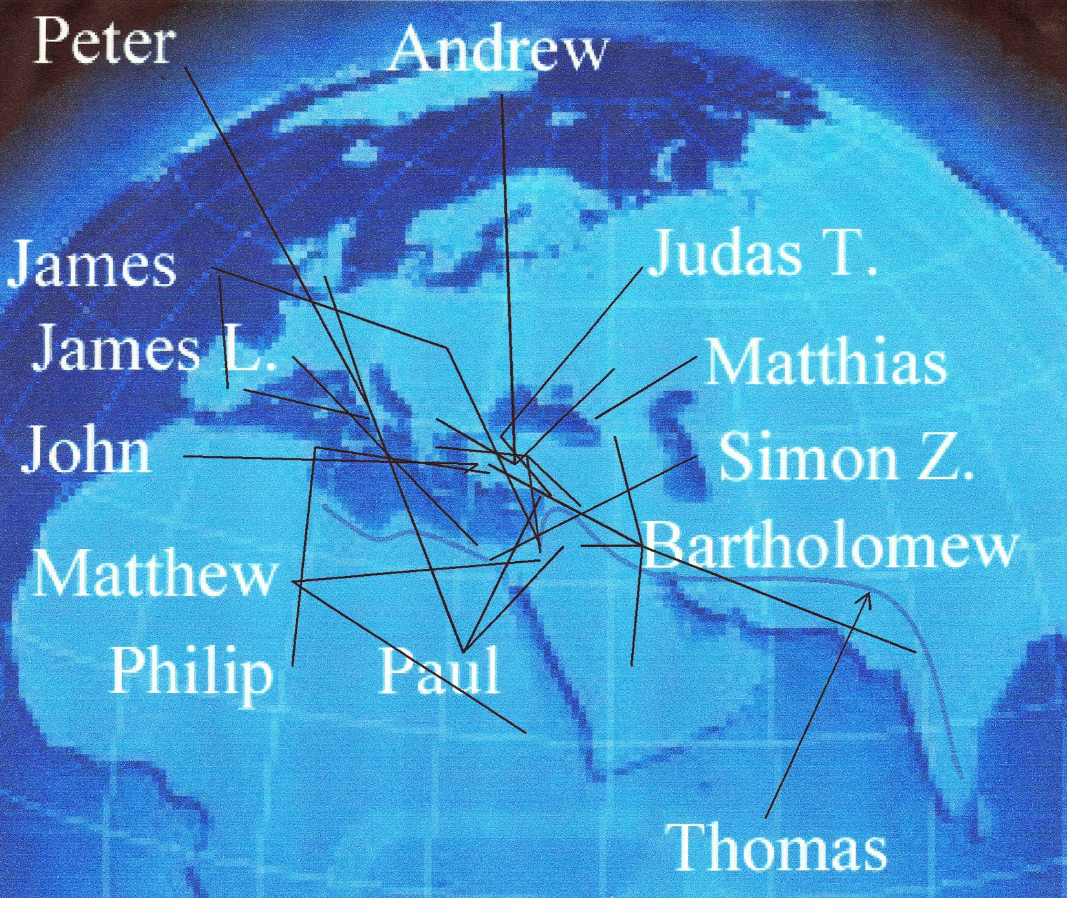
In one brief lifetime…

Slide 19
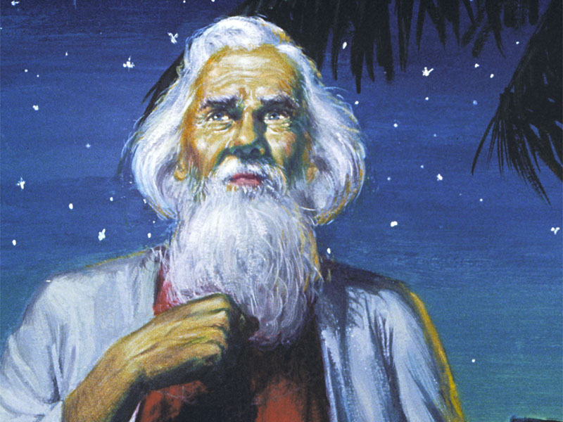
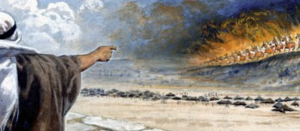
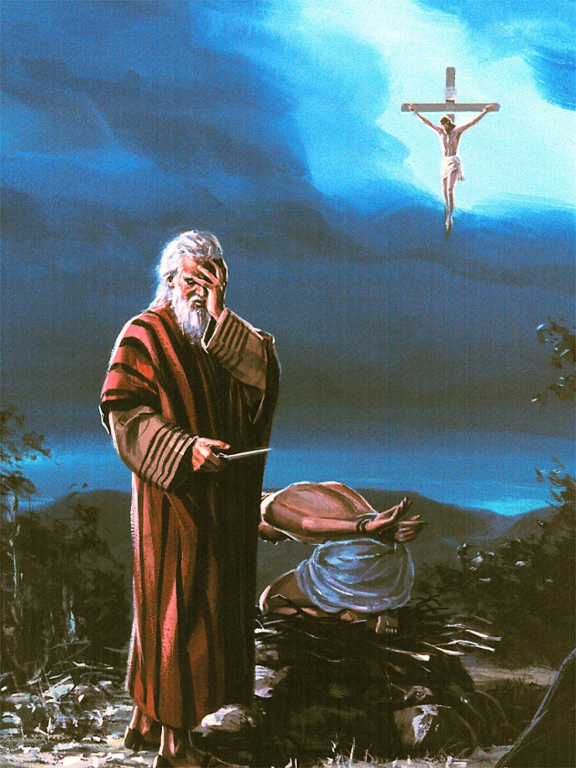
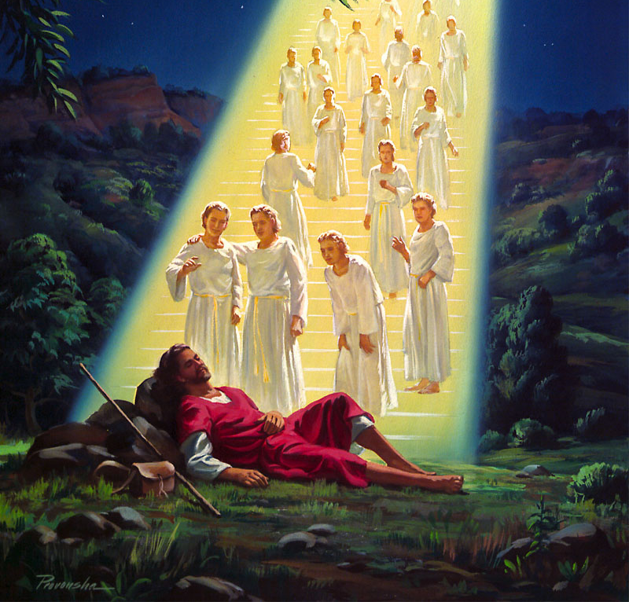
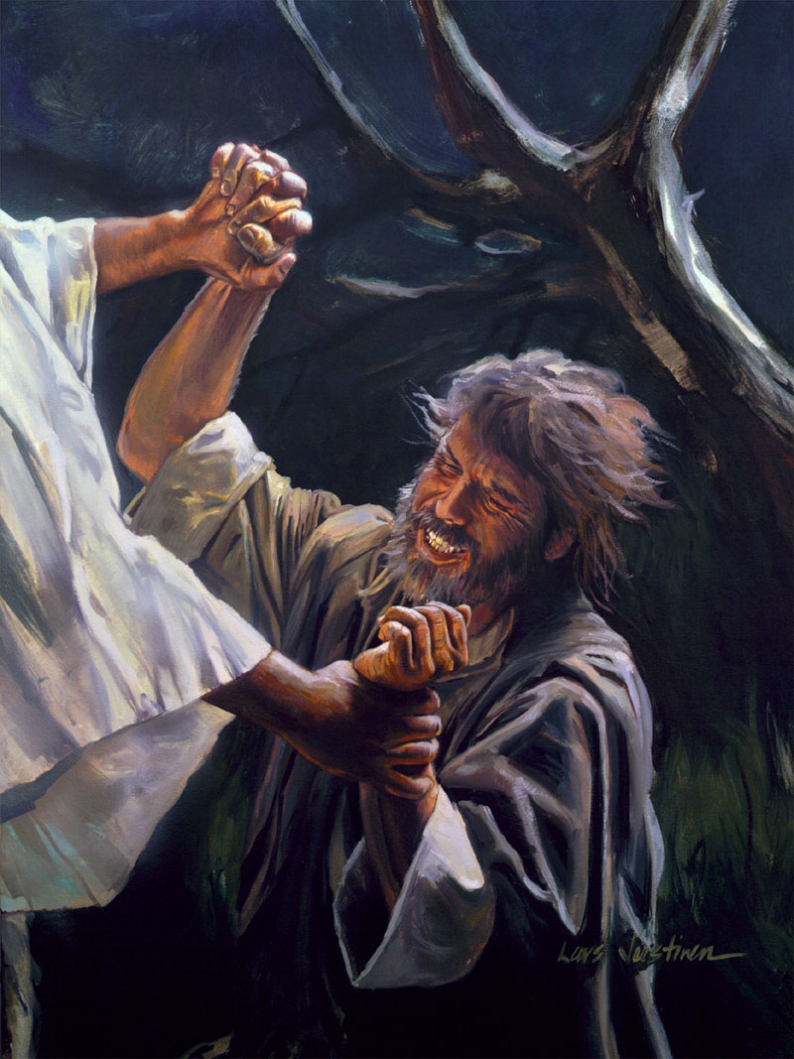
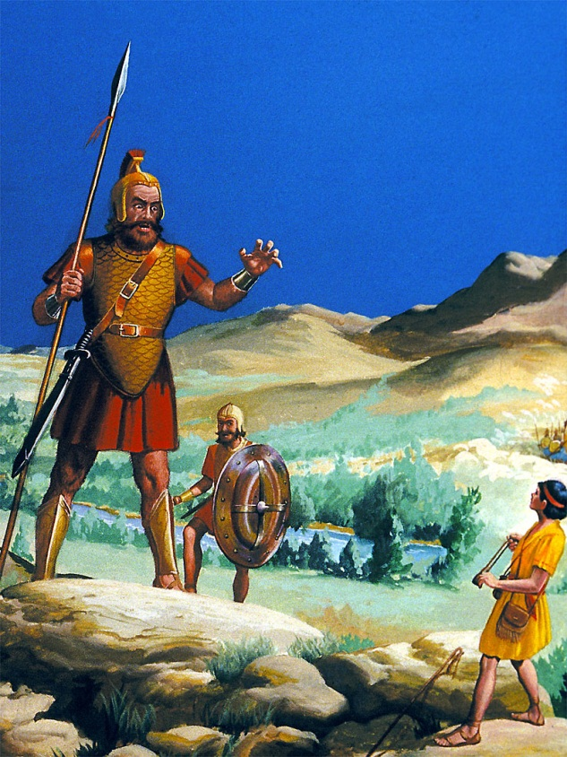
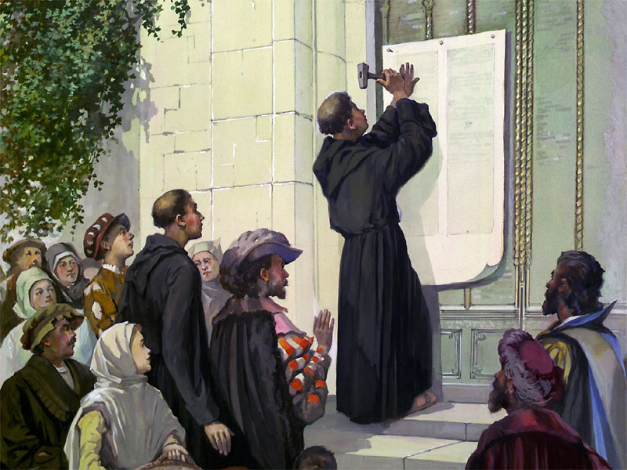
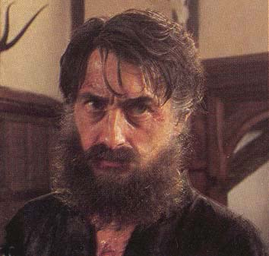
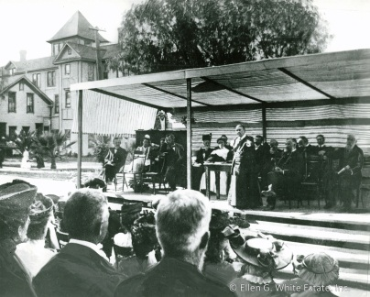
“Not by might,
nor by power,
but by my spirit,
saith the LORD of hosts.” Zech. 4:6
Notes:
“Not by might, nor by power, but by my spirit, saith the LORD of hosts.” Zech. 4:6

Slide 20
Assignment:
Start reading John
Slowly – a few verses at a time
Prayerfully – wait on the Lord!
What is he really saying – From his day to our day
What does it mean to me – It will be relevant to you
We have a whole year to spend with John

Slide 21
Enjoy
Notes:
For many, the gospel of John is the most precious book in the NT, as Psalms is in the OT. It’s message capable of connecting our hearts to God like none other.
John did not write until almost An 100. His Gospel is, therefore, the product of long thought and of long living with Jesus and of long experience of the Spirit. W. M. Macgregor has a sermon entitled What Jesus becomes to a man who has known him long, and that is an excellent description of John's Gospel. John was more concerned with the meaning of the facts of Jesus' life than with the facts themselves. It is in John that we get the highest teaching of the Spirit. "I have yet many things to say to you, but you cannot bear them now. When the Spirit of truth comes, he will guide you into all truth" (John 16. 12, 13). For John that promise had come true; he saw things that only years in the Spirit could teach; and his Gospel may well be called the Gospel of the Sprit. William Barclay, Many Witnesses, One Lord. http://www.religion-online.org/showchapter.asp?title=1112&C=1170

Slide 22
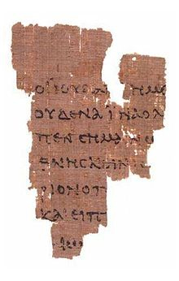
Gospel of John: Papyrus 52
Probably the earliest surviving New Testament manuscript, Rylands Library Papyrus, is a Greek papyrus fragment discovered in Egypt in 1920 (now at the John Rylands Library, Manchester). Although P52 has no more than 114 legible letters, it must come from a substantial codex book; as it is written on both sides in a generously scaled script, with John 18:31-33 on one side and 18:37-38 on the other.
The surviving text agrees closely with that of the corresponding passages in the Gospel of John, but it cannot necessarily be assumed that the original manuscript contained the full Gospel of John in its canonical form. Metzger and Aland list the probable date for this manuscript as c. 125…
Other notable early manuscripts of John include Papyrus 66 and Papyrus 75, in consequence of which a substantially complete text of the Gospel of John exists from the beginning of the 3rd century at the latest. Hence the textual evidence for the Gospel of John is commonly accepted as both earlier and more reliable than that for any other of the canonical Gospels.

Slide 23
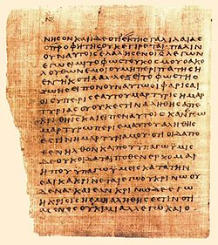
Gospel of John: Papyrus 66
A near complete codex of the Gospel of John.
Part of the Bodmer Papyri including: John 1:1-6:11, 6:35b-14:26, 29-30; 15:2-26; 16:2-4, 6-7; 16:10-20:20, 22-23; 20:25-21:9, 12, 17.
Not included is the story of the adulteress (7:53-8:11).
One of the oldest New Testament manuscripts known to exist, with its writing dated to around 200 CE.
Found in 1952 at Jabal Abu Mana near Dishna (Egypt). The preservation level surprised scholars because the first 26 leaves were basically fully intact, and even the stitching of the binding remained.
It was published in 1956 and it was the most important New Testament manuscript publication since the Chester Beatty Papyri in 1933-1934.
It is currently housed at the Cologny-Geneva, Switzerland: Bibliotheca Bodmeriana.

Slide 24
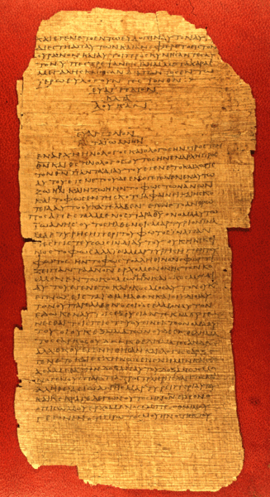
Gospel of John: Papyrus 75
Originally it contained about 144 pages ... of which 102 have survived, either in whole or in part.
It contains about half the text of Luke and John in Greek
It is dated as being an early third century manuscript. One the earliest manuscripts. The surviving fragment contains Luke 3:18-24:53
An unusual feature of this codex is that when the Gospel of Luke ends, the Gospel of John begins on the same page.

