Slide 1
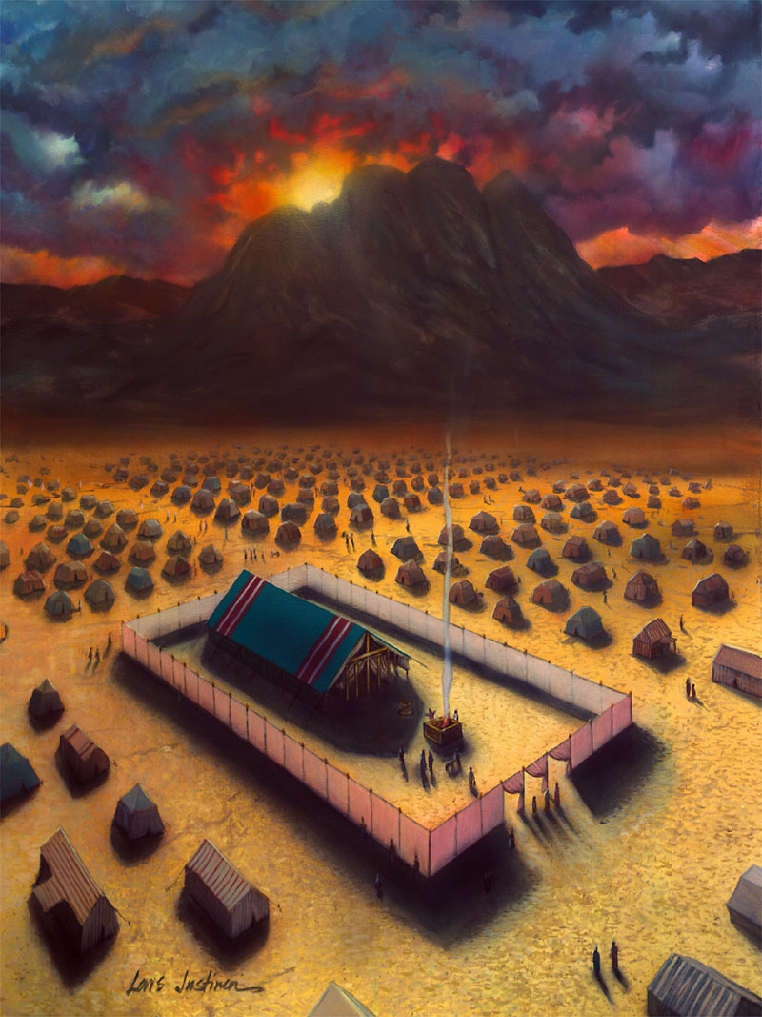
Good News discovered in the Sanctuary Willits 9-29-2012 Fort Bragg 11-3-2012

Slide 2
The Sanctuary
Is it Good News?
Although it is 8th in our 28 official belief’s, it has rarely been considered “Good News.”
It isn’t our most understandable or attractive belief
It requires complicated explanations, is difficult to find an emotional or viable connection with
Slain animals doesn’t warm our hearts.
In the first three editions of our doctrines (1872, 1889 and 1931) the main purpose of the sanctuary doctrine was to determine who will be saved and lost.
Is this how God sees the sanctuary?
When we are ashamed of, seek to apologize for one of our doctrines it is quite possible we don’t understand it.
Our doctrines must be about God, and therefor should be good news...
The 1980 sanctuary statement introduces for the first time: the vindication of God.

Slide 3
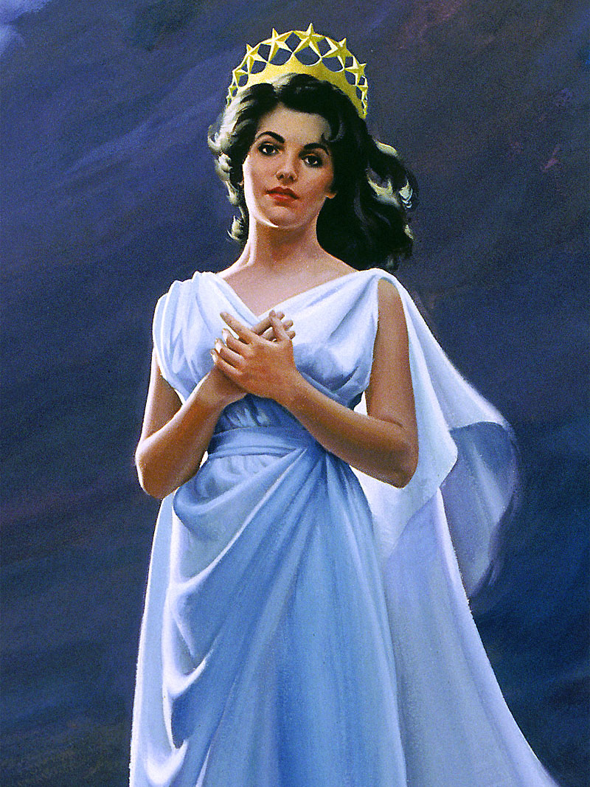
Marriage
The Bible ends with a Wedding Theme:
“And I heard a great voice out of heaven saying, Behold, the tabernacle of God [is] with men, and he will dwell with them, and they shall be his people, and God himself shall be with them, [and be] their God.” Rev. 21:3
The bride has made herself ready for her Divine Consort
God “tabernacles” מִקְדָּש (miškan) with his bride – they are one!
Moses is a shoshben a groomsman:
"the friend of the bridegroom" who leads the bride (Israel) out from slavery to be married at the mount to God. (Ex. 19:17; Ps. 68)
His responsibility was to make all the arrangements for the wedding:
bringing the bride and bridegroom together.
oversee the development and pledge of their vows
only when that was done could he go away rejoicing, his task completed, the lovers together.
The Sanctuary is all about a Wedding!
Rev. 21:2 “I John saw the holy city, new Jerusalem, coming down from God out of heaven, prepared as a bride adorned for her husband.”

Slide 4
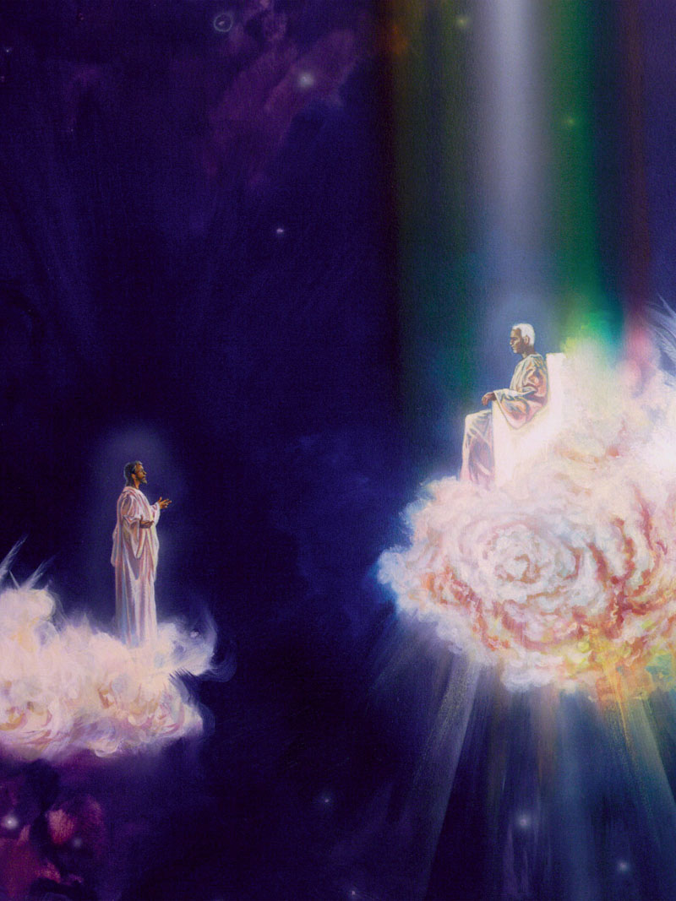
Church is a Bride
"The Spirit and the bride say, Come. And let him that heareth say, Come." Revelation 22:17
“Come hither, I will show thee the bride, the Lamb's wife.” “He carried me away in the spirit and showed me that great city, the holy Jerusalem, descending out of Heaven from God.” Revelation 21:9, 10
In the Revelation the people of God are said to be the guests at the marriage supper. Revelation 19:9.
Christ receives the New Jerusalem, the capital of his kingdom, “prepared as a bride adorned for her husband.” Daniel 7:14; Revelation 21:2.
The followers of Christ are to “wait for their Lord, when he will return from the wedding.” Luke 12:36.
In the parable of Matthew 22 marriage is introduced, and the investigative Judgment is clearly represented as taking place before the marriage. Previous to the wedding the king comes in to see the guests, Matthew 22:11.—to see if all are attired in the wedding garment, the spotless robe of character washed and made white in the blood of the Lamb. Revelation 7:14.
"I will betroth you to me for ever" Hosea 2:9, 20

Slide 5
The Wedding
“tabernacling” מִקְדָּש (miškan) with them
Veiled behind three progressive compartments:
The courtyard
The Holy Place
The Most Holy Place
The Bride (Israel) by journeying through these compartments discovers all the Groom has done to win her heart.
The extent of his love for her awakens her love to him – 1 Jn. 4:19; 1 Pet. 1:15-16; Lev. 20:7, 8
The Sanctuary is the place where the chasm (sin) that separates God from his church is removed.
The law – written in the heart is the means of restoring holiness to his people “Be holy because I, God, your God, am holy” Lev. 19:2
God tabernacles with his Bride in the Sanctuary
literally abiding with his bride for 40 yrs
Ex. 25:8 “And let them make me a sanctuary; that I may dwell among them.”

Slide 6
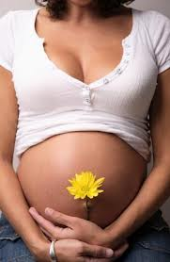
Biology imitating Theology
Becoming One:
Why is it that the brides body doesn’t attack and destroy sperm? (Gen. 3:15)
Why is it that it allows the egg & sperm to unite and grow? (Matt. 13:31)
Why is it that the fetus is treated as one with the mother’s body?
Because: the Mother mysteriously recognizes the sperm as self!
The women represents a Church: a safe place [sanctuary]where the groom [Christ]can entrust his offspring to be nourished until birth

Slide 7
Interaction
Have you had difficulty seeing the Sanctuary teaching as Good News?
How does picturing it as a wedding ceremony change the way you look at it?
Seeing how Jesus is wooing us back
How this theme runs throughout the bible…
Is the previous slide helpful in understanding the role of the church/bride?
Does this help make the Sanctuary Good News?

Slide 8
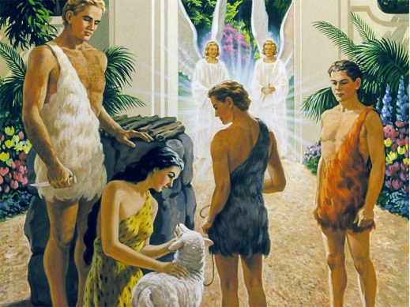
Adam
Heavenly Groomsmen
the šāmar the guardian of our world:
His sin forced him to surrender that role to the cherubim.
To preserve their home from the effects of immortalizing sin, God “stationed” (literally, “caused to camp,” שׁכן) angels at the eastern gate to the garden (Gen. 3:24)
These cherubim were to “guard” (šāmar) i.e. with “flaming sword flashing back and forth” (cf. Ps 104:4) against sinful intruders.
A role later played by the shoshben, or groomsmen
Paradox: Adam, once the (šāmar , Gen. 2:15) of Eden is exiled from it.
Cherubim now guard it from him!

Slide 9
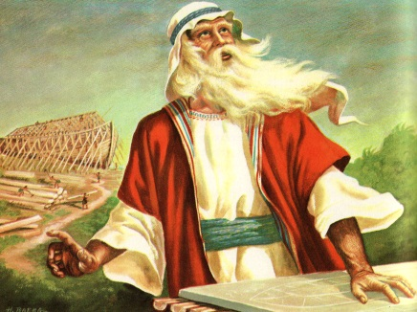
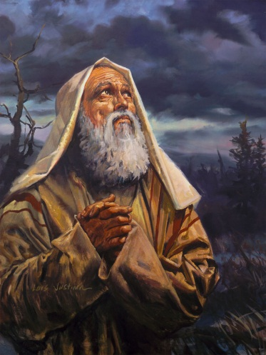
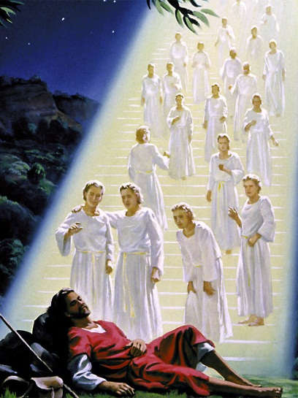
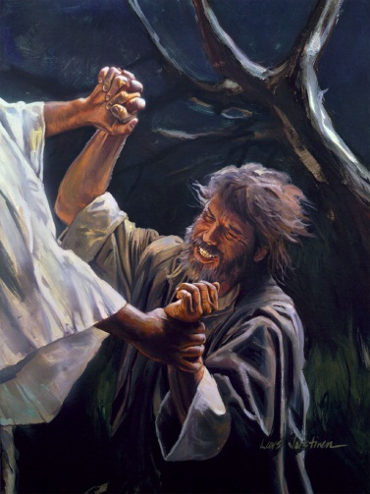
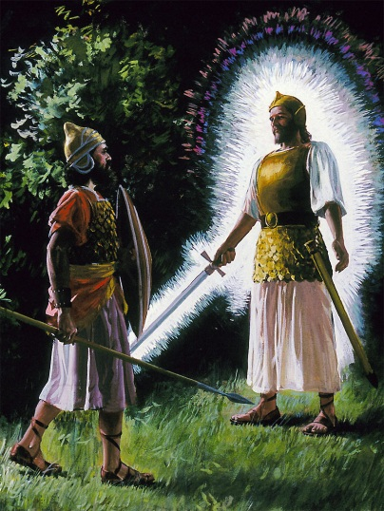
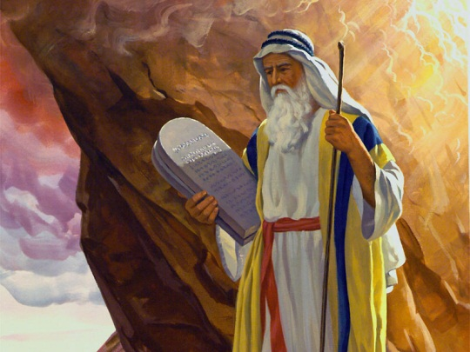
Guardians to restore Divine/Human connection
Noah – gifted to see & know what others could not
Abraham – trained his family in how to walk with God by faith - Heb. 11:8; becoming God’s friend – Heb. 11:17-19
Jacob – from self consumed to selfless (Israel)
Moses – face to face w/ God, giver of the law
Joshua – faithful servant/leader
Daniel/John – guides throughout time
Paul – transformed from enemy to the greatest evangelist and theologian the world has ever seen. Who could say “I know whom I have believed, and am persuaded” 2 Tim. 1:12
“Henceforth I call you not servants; for the servant knoweth not what his lord doeth: but I have called you friends; for all things that I have heard of my Father I have made known unto you.” Jn. 15:15
“seeing we also are compassed about with so great a cloud of witnesses, let us lay aside every weight, and the sin which doth so easily beset [us], and let us run with patience the race that is set before us” Heb. 12:1

Slide 10
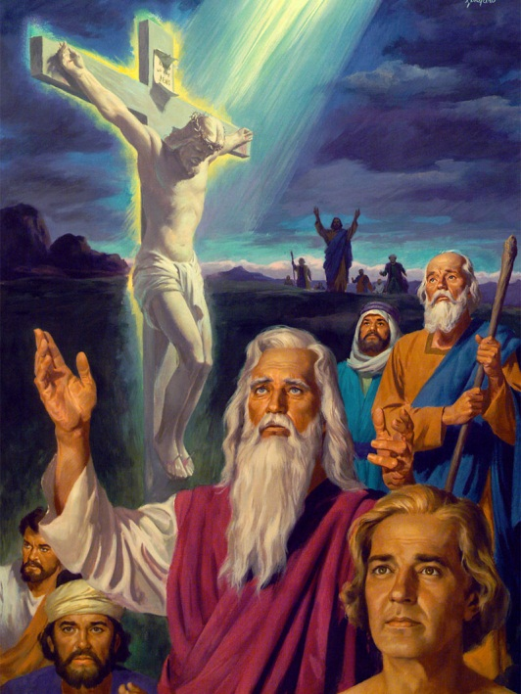
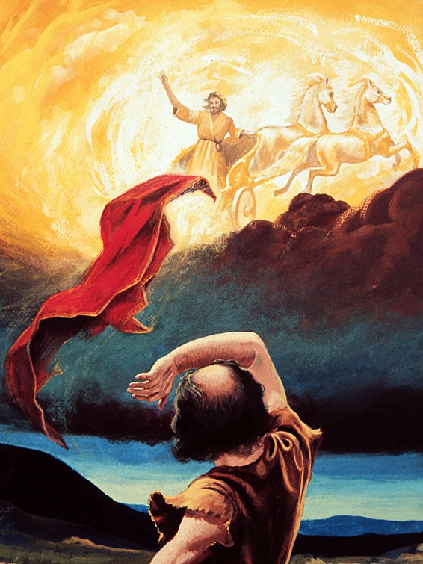
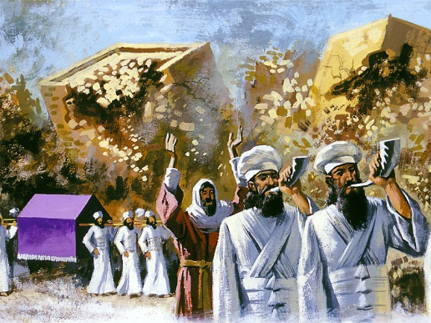
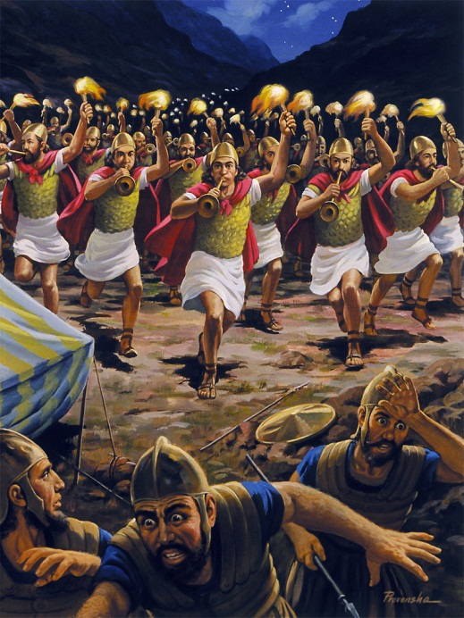
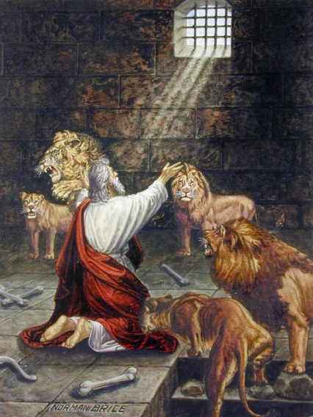
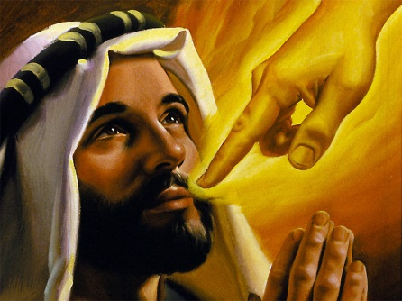
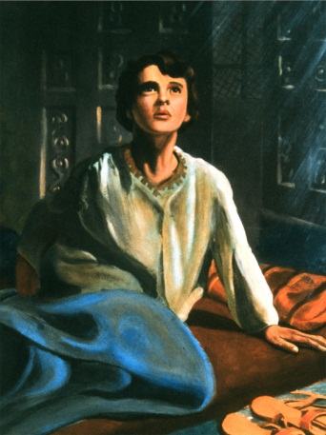
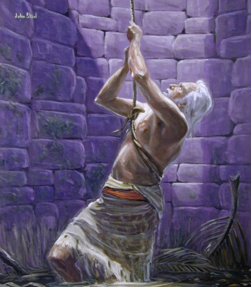
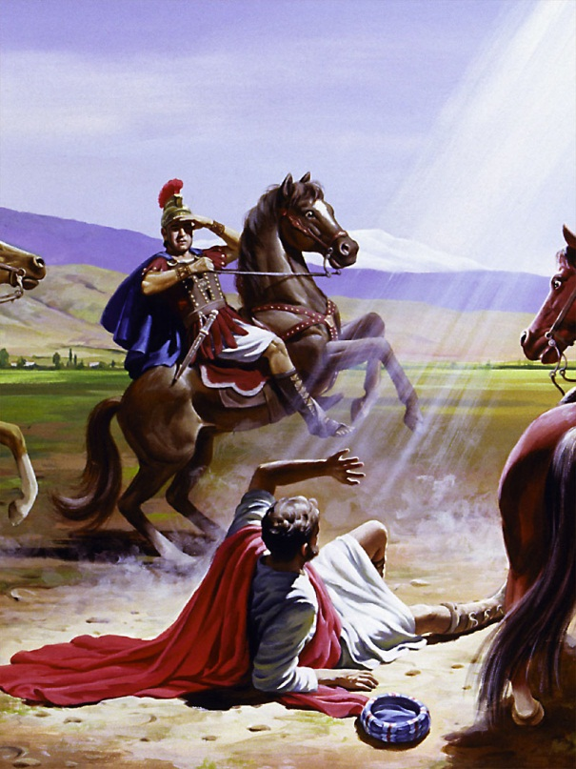
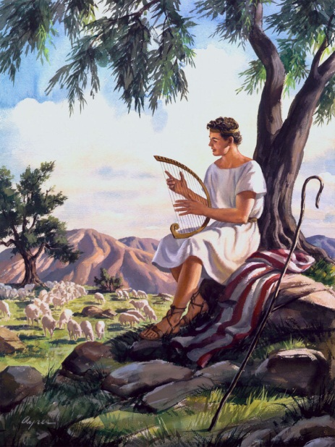
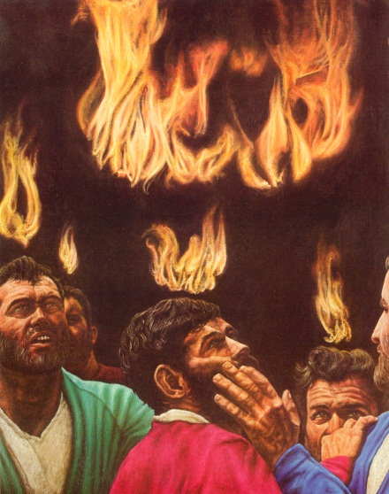
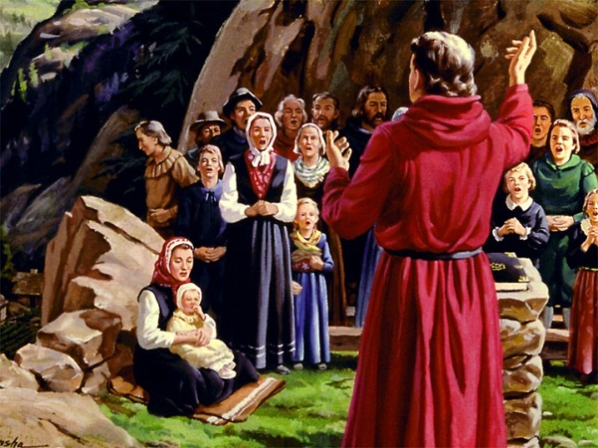
God’s Guardians

Slide 11
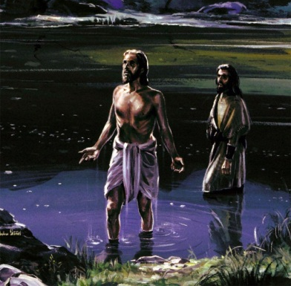
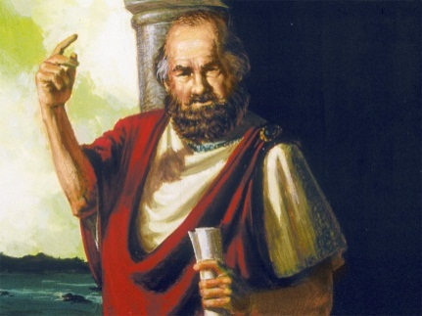
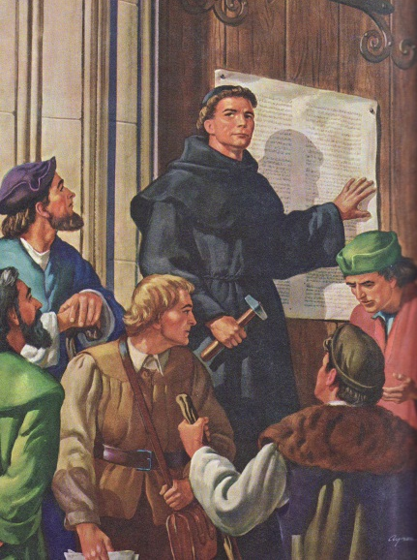
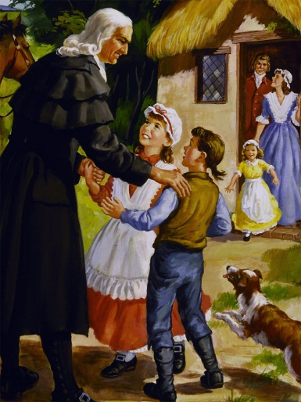
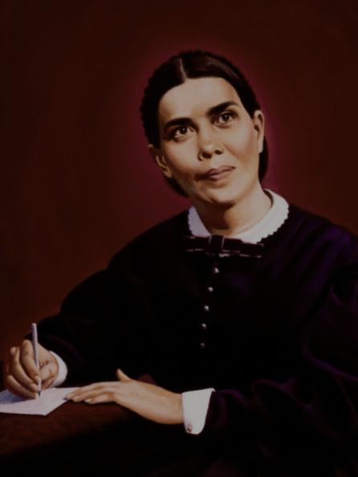
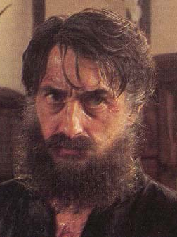
other shoshben
John the Baptist:
"He who has the bride is the bridegroom. But the ‘friend of the bridegroom’ who stands and listens for him, rejoices at the sound of the voice of the bridegroom. So, then, my joy is complete. He must increase, but I must decrease" (John 3:29,30)
Paul the Apostle:
To the Corinthian church he said: "for I betrothed you to one husband, I wished to present a pure maiden to Christ..." 2 Cor. 11:2
Paul had in mind here his responsibility to guarantee the chastity of the bride. He will do all he can to keep the Corinthian Church pure for her Groom, Jesus Christ.
Jesus’ Disciples…
Cheerfully gave their lives to fulfilling the mission he gave them…
The Christian Church…
Great Preachers, Missionaries, Teachers, etc.
unconcerned about themselves, instead consumed with preparing the bride for the wedding.
SDA (remnant) Church

Slide 12
Interaction
Who have been the groomsmen/guardians in your life?
Devoting their lives to helping you to know and love Jesus.
Teachers, Parents, Pastors, Friends, etc.
Whom are you a groomsmen/guardian to?
Devoted to preparing them to the task of making Christ’s Bride ready for the wedding
What is it like being a groomsman/guardian?

Slide 13
The Passion/Betrothal Week
SUNDAY: the Wedding Procession
The Sunday (the 9th day of Nisan in A.D. 31), Jesus rode into Jerusalem on a donkey, just as Zechariah had pictured (9:9) to marry His bride - Zion. and Judean king’s take their throne
It was customary to wave palm and myrtle branches before the king and the couple, and accompany them with musical instruments and singing along their procession to the grooms house or the throne. All who met them were expected to join in on the celebration.
Love songs were sung in praise of the bridal pair (Jer. 16:9), examples of which survive in Ps. 45 and in the Song of Songs. An enthronement song can be found in Ps. 24:7-10
Sunday Jesus called the Temple “My House”
Leading the procession (both enthronement & marital) in the Spring of AD 31 was Lazarus, Jesus’ best groomsman. The king/groom’s attendants would return to Bethany that night.
One quarter of Matthew's & Mark's Gospel, 30% of John, comes from events that happened during this one week.

Slide 14
The Passover Lamb
MONDAY: arrangements for the Dowry (The Passover Lamb is Chosen)
Passover lamb is set aside (Ex. 12:3) Each pious Israelite householder selected a perfect yearling male lamb or kid on the 10th of Nisan. This was tethered in a public place so that it might be observed by all, ready for it’s killing on the 14th of Nisan. These four days of public display were designed to stimulate conversation concerning the role of the lamb in the deliverance of Israel.
Josephus tells us 240,000 lambs slain during each Passover during these years
while thousands of Paschal lambs were being readied for sacrifice, Jesus was set apart to pay the price for his bride (John1:29; 11:50,51; 1 Cor. 5:8)
Also on Monday
Jesus cursed the fig tree that failed to produce fruit
The 2nd Temple cleansing that allowed access to the blind/lame and singing children (Mt. 21:12-17)
Monday and Tuesday Jesus lingers around the Temple as if in anticipation of his bride
That same night, the Sanhedrim (the traitorous groomsmen) was illegally summoned to condemn Jesus (their king, groom) to death.

Slide 15
Ten Virgins awaiting the Bridegroom
TUESDAY (last day in public)
Jesus tells a story about a Wedding Feast (Matt. 22:1-14)
invitations went unappreciated, so the riff raff welcomed in their place
groom is rejected by his bride (she refuses to wear the wedding dress he provided)
NIGHT: Jesus observes preparations for a wedding taking place (Matt. 25:1ff)
It wasn’t unusual for the bridegroom to come unexpectedly to the brides house
sometimes in the middle of the night, accompanied by friends with tambourines, a band, and herald’s announcing “Behold! The bridegroom is coming.”
the delay in his arrival resulted in half of the virgins not having sufficient oil to meet him
Finally the heralds and bridesmaids escort the bride and her companions to the grooms house
Jesus spends the night grieving – his bride has rejected him! (Matt. 23:37-39)

Slide 16
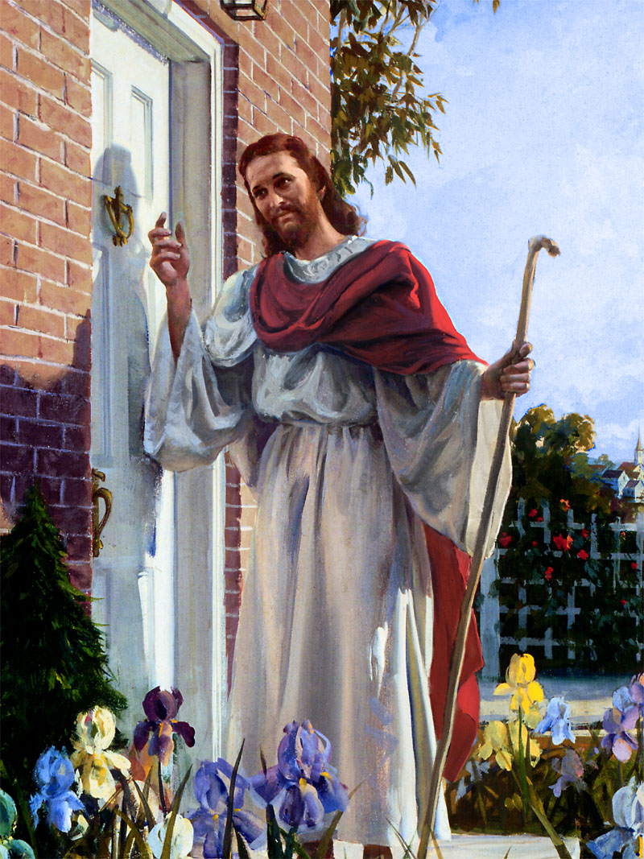
Rejected!
“O Jerusalem, Jerusalem, [thou] that killest the prophets, and stonest them which are sent unto thee, how often would I have gathered thy children together, even as a hen gathereth her chickens under [her] wings, and ye would not! Behold, your house is left unto you desolate. For I say unto you, Ye shall not see me henceforth, till ye shall say, Blessed [is] he that cometh in the name of the Lord.” Matt. 23:37-39

Slide 17
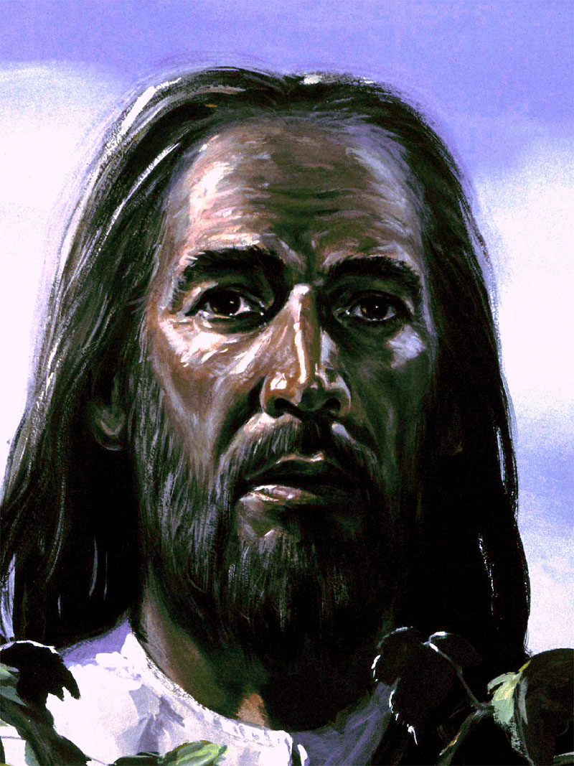
Rejected!
“He is despised and rejected of men; a man of sorrows, and acquainted with grief: and we hid as it were [our] faces from him; he was despised, and we esteemed him not. Surely he hath borne our griefs, and carried our sorrows: yet we did esteem him stricken, smitten of God, and afflicted.” Isa. 53:3,4

Slide 18
Dinner with his Groomsmen
WEDNESDAY - THURSDAY – Wedding day (Passover)
Marriages were commonly celebrated on Wednesdays.
Every Thursday, the Sanhedrim sat, allowing for the husband, if he had a charge to prefer against the chastity of his bride, to make immediate complaint, and secure a bill of divorcement.
While all Jerusalem was preparing for the Passover, Judas is bargaining with the Priests to betray Jesus
Thursday aft. the Passover lambs were slain (between the sun’s first decline and final disappearance) and then eaten in the early evening
Thursday eve. Jesus spent with his disciples eating his first and only Passover with them saying ‘With desire have I desired to eat this Paschal with you before I suffer.’ and ‘I say unto you, I will not eat any more thereof, until it be fulfilled in the Kingdom of God.’
Thursday night began the removal of all leaven from the house. All of it must be removed by noon Friday.
Jesus needed to pray with his disciples, they slept. Late that night he was formerly betrayed by Judas, denied by his disciples, incarcerated and tried before the Sanhedrin throughout the rest of the night.

Slide 19
Dowry Paid
FRIDAY – the Trial, Crucifixion, Death of Jesus
Morning
Jesus is tried again before the Sanhedrin
Judas’ confession & suicide
Jesus is tried before Pilate/Herod/Pilate – beaten, crown of thorns, scourged, forced to carry his cross.
Midday into afternoon
Leaven (motivation of life) removed from the home (Lev. 16:33, 30; Dan. 8:14) by noon
Paschal lambs (& Jesus) slain; God departed from the Temple (veil torn - top to bottom)
Passover meal eaten/graves are opened (Matt. 27:52)…
Jesus is put in Joseph of Arimathaea’s tomb just before sunset
The dowry (Mohar) for his bride is paid (acceptance meant she was legally his)
But where is the bride?

Slide 20
Sabbath Rest
On Earth
Jesus was finally at rest
But not others:
While an unearthly stillness hung over Calvary many felt horror over what just happened
In the blackness that surrounded the Cross they concluded a great wrong had happened!
The Holy Spirit began to guide their minds to truth. Never had he attracted as much attention as when he lay resting in his tomb
In Heaven
Lucifer’s guise was torn away when Jesus said “It is finished”
His character now was made painfully clear – – The angels he formerly led, now were ready to cast him out!
They would soon be cast to earth to wreck havoc against Christ’s church.

Slide 21
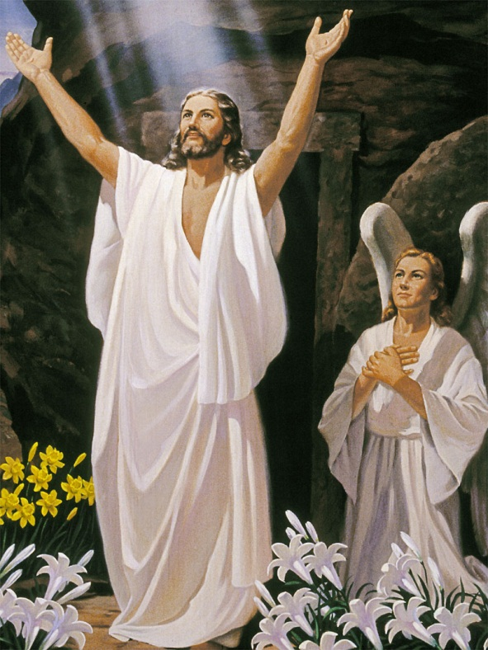
Wedding Delayed – Promises Made
SUNDAY (the Celebration)
Resurrection
Was the dowry enough?
Jesus must know
hence “don’t hold me back” I must see my father.
bones of saints strewn about on Fri. come alive
wave sheaf
Pentecost (50 days later)
Jesus’ priestly prayer (John 17) being fulfilled
Ascension with his first fruits
Victory (Satan’s lies are exposed)
Lucifer no longer Shoshben - cast out of heaven Rev. 12
Wedding Feast delayed Rev. 21:3; 19:7-9

Slide 22
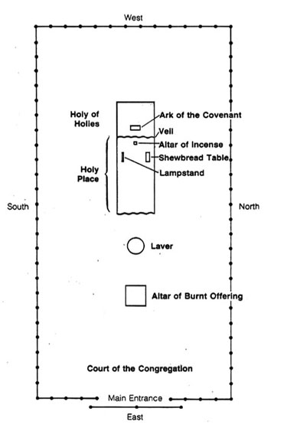
Sanctuary
OUR JOURNEY
Most Holy Place
Ark (Marriage/Oneness)
Holy Place
Altar (Prayer)
Lampstand (Holy Spirit)
Shewbread (Word)
Courtyard
Laver (Baptism)
Altar (Death)
JESUS ׀ CHURCH ׀COUPLES

Slide 23
Interaction
Does viewing the sanctuary as a wedding help it to be good news?
What/whom are represented throughout it parts?
What is the goal in the sanctuary?
Has it been achieved yet?
Will it be achieved?
What is the message for Church/Couples?
How is all this Good News?

Slide 24
The End

Slide 25
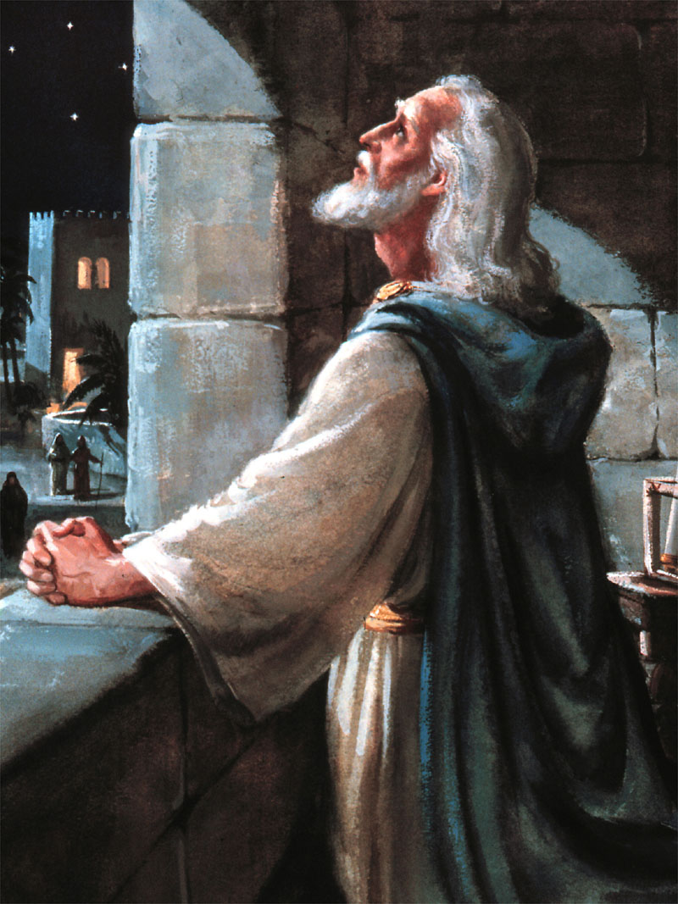
Stolen away from his beloved home in Israel by a heathen King
Two men who would change the world
One the Empire builder, the other his counselor
In three great visions given Daniel (Dan. 2,7,8-9) – God outlines the specifics of how he planned to restore his church:
From the restoration of their independence
To his Incarnation, Ministry, Death
To his Cleansing of the Heavenly Sanctuary
And finally the ultimate rescue of his Church
His prophecies have stirred mankind for centuries
Daniel
6th C. BC

Slide 26
Great Advent Awakening
In 1815, this self educated man began a life-long quest to:
know God and what His expectations were for him
his deist friends challenged him about the “errors” and “contradictions” in the bible
a captain in the war of 1812, he knew it was a miracle he survived – there must be a God!
he set out to prove them wrong
Beginning in Gen. 1:1 (verse by verse) not moving on until he could explain it’s meaning.
He discovered Jesus to be a personal loving Savior and God does predict future events.
Dan. 8:14 captured his attention:
"Unto two thousand and three hundred days; then shall the sanctuary be cleansed."
He concluded this prophecy extended to his time, just 25 years (1843) away!
Is that when the Lord would return? To be sure he spent the next 15 years verifying his conclusions.
So thoroughly did he do his work, that later he could say no objection came to him that he hadn’t already studied.
William Miller 1782-1849

Slide 27
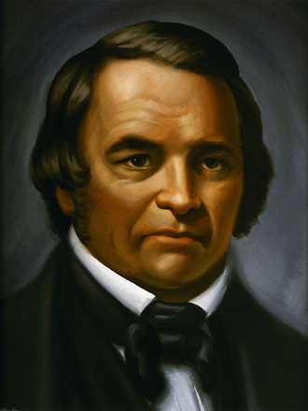
Arriving at his conclusions caused a burning in his soul to:
“Go and tell it to the world” - “Behold, the bridegroom cometh!”
The passion of his life from then on
All throughout the Northeast he preached stirring amazing interest and
revival (130 campmeetings, endless church lectures, 500,000 people)
During 1843 Samuel S. Snow discovered an unforeseen error in his calculations
there was only 1 year between 1 BC and 1 AD – therefore the prophecy would extend till 1844
He declared that just as Jesus had arrived exactly on time in the prophecy - the events at the end would be on time too
The starting point was in the fall of 457BC, and would extend to the fall of 1844,
That date, according to the Karaite Calendar was Oct. 22!
But the Lord didn’t come in 1844 even though tens of thousands expected him too
The day after their disappointment, in upstate NY, Hiram Edson, a farmer, was walking to encourage some nearby believers, when just like with Daniel, Stephen, and John, the heavens opened up and he saw:
Jesus, in heaven, going to his Father (Dan. 7:13), to be married. The marriage must precede his return.
THE SANCTUARY MESSAGE WAS ABOUT A MARRIAGE - getting the bride ready for her groom!
The entire book of Revelation is about the Heavenly Sanctuary & a Wedding!

Slide 28
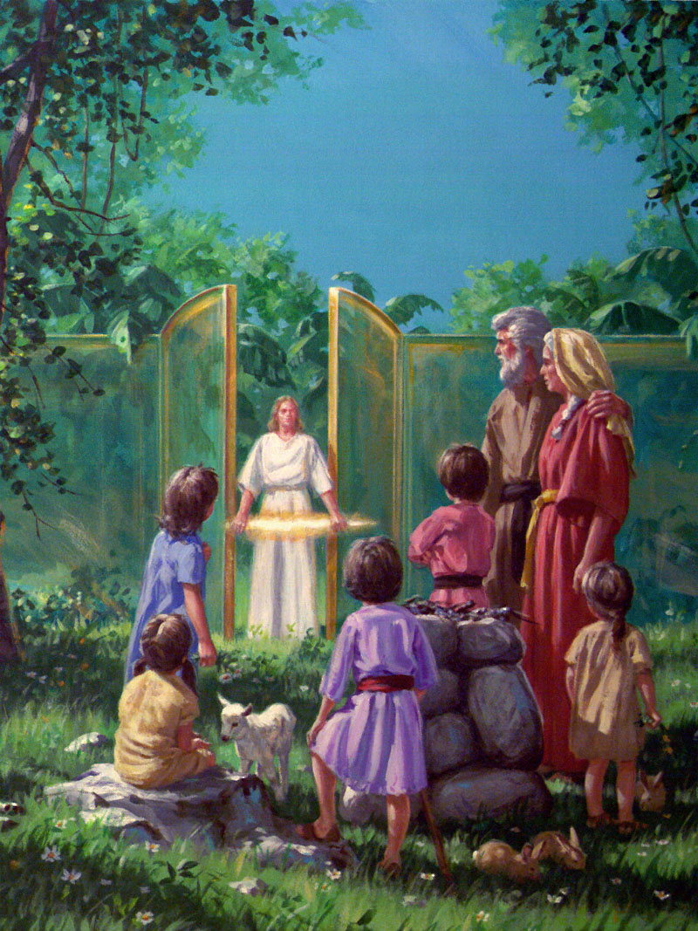
The Marriage Failed
The most devastating words in the pre-flood
world:
“God drove [גָרַשׁ, gāraš ] cast out/ away,
divorced, expelled, put away, thrust out]
Adam and Eve out of the garden…” Gen.
3:24
גָּרַשׁ, gāraš = driven away by force,
divorced, violently expelled, precluding
the possibility of their return.
i.e.:
Cain being expelled from God’s presence and forced to become a defenseless wanderer among men (Gen. 4:14).
Abraham sending Ishmael and his mother Hagar away so as to remove all possible rivals to Isaac (21:10, 14; 25:6).
The scapegoat being expelled from the camp of Israel (Lev 16:10).

Slide 29
Divorce
The first divorce in history was
between God and his people:
DIVORCE in Hebrew kerîthîth, meant “dismissal,”
literally, a “cutting off,” [from karath]
God hates divorce - Malachi 2:16
Prior to the divorce legislation in Dt. 24:1-4:
The Israelites, and the ancient world apparently
divorced their wives without any formality by simply ordering them out of the house. Abraham did this to Hagar, whom he had married (Gen 16:3; Gen 21:9–14).
Divorcing meant the man dismissed his wife, cast her adrift to fend for herself in a society where she had no place. A world that was unsympathetic and hostile toward her.
God mercifully ordained that a divorced woman be given a certificate of divorcement, allowing her to legally and properly become the wife of another man without any stigma attaching to her.

Slide 30
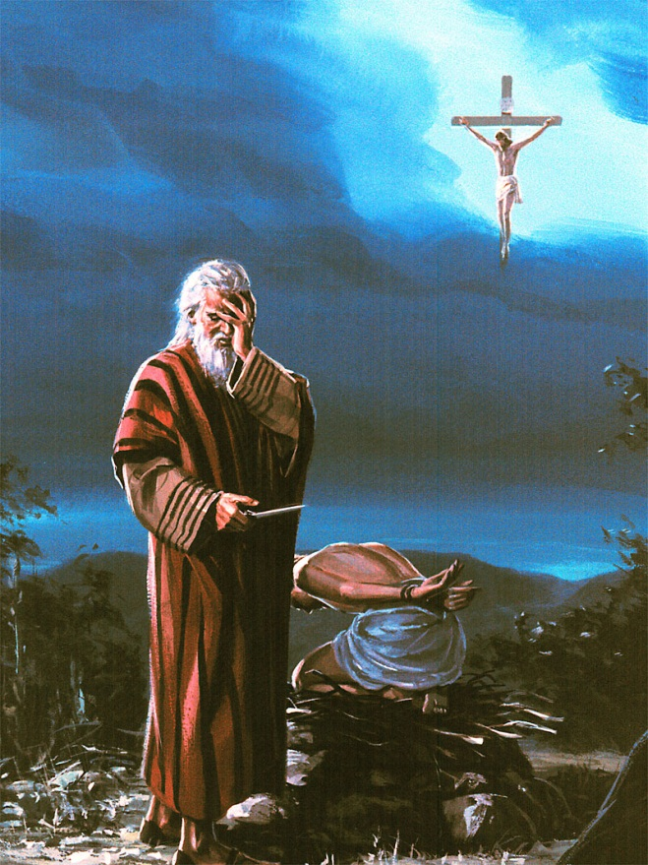
Jesus & Divorce
He declared (Matt. 19:3-9) that the Mosaic divorce code
was introduced because of the hardness of the people’s
hearts (cf. 1 Cor. 7:10,11)
But originally, “it was not so” (Mt 19:3–9; cf. 1 Cor 7:
10, 11) implying it was more gracious. He stated that a
man who divorced his wife for any reason except marital
infidelity committed adultery by remarriage (Mt 5:31,
32; 19:3–9).
The Solution:
As soon as there was sin, Jesus was there to offer the solution - the sacrificial system (Gen. 3:15)
Example:
Hosea & Gomer…
Woman caught in adultery…
Oneness, intimacy, trust, peace – restored not by a lion but a lamb (Rev. 13:8)!
Marriage represents that oneness – (Gen. 2:24)

Slide 31
Interaction
Because divorce has become such a huge problem today:
Leaving a lifetime of scars on everyone
Robing people of naturally feeling safe/bonded
How do you feel about God divorcing us?
Has his treatment of the divorced been more gracious than ours?

