Slide 1
Willits August 4, 2012 Fort Bragg August 11, 2012
The Good News………
about Church
What’s so great about Church?

Slide 2
Is Church a success?
2010 – 2.18 billion Christians worldwide (33.32% of global population)
26% in Europe
37% in Americas
24% in sub-Saharan Africa
13% in Pacific & Asia
Since 1910 the world population of Christians has jumped from 600 million to 2.18 billion (current world population is 6.9 billion)
1910 – 93% of Christians lived in Europe and Americas
Today only 80% of Americans are Christian (Compared to: Brazil 90%; Philippines 93%; Mexico 93% Middle East 4%)
Worshipping in 350,000 churches
60% in churches with attendance of less than 100
In number of members, SDA church ranks 23rd in NA & Canada
Notes:
Statistics from Pew Forum on Religion and Public Life from Pew Research Center: http://christianity.about.com/gi/o.htm?zi=1/XJ&zTi=1&sdn=christianity&cdn=religion&tm=123&f=10&tt=11&bt=0&bts=0&zu=http%3A//www.pewforum.org/Christian/Global-Christianity-exec.aspx
World Religion Statistics see http://chartsbin.com/view/3nr
http://www.30-days.net/muslims/statistics/world-stats/

Slide 3
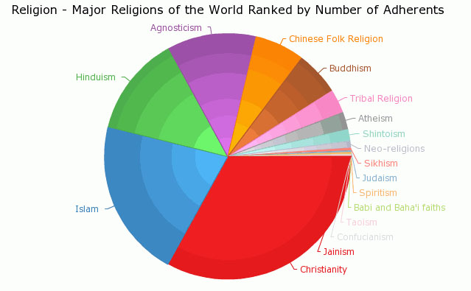
Pie Chart of World Religions

Slide 4
Attitudes about Church:
59% of young Christians disconnect either permanently or for an extended period of time after age 15, pointing the finger of blame on the church saying You Lost Me!
many teens grow up concluding Christianity is boring, old-fashioned and out of touch with reality
Their top desires from church is for it to assist them in
connecting with God
learning about their faith
serving others
developing loving and relational environments
Notes:
Another obligation, too often lightly regarded,--one that to the youth awakened to the claims of Christ needs to be made plain,--is the obligation of church relationship. {Ed 268.4}

Slide 5
Attitudes about Church cont.:
But they are disappointed
teens are four times more likely to go online than to seek helpful spiritual perspectives and insight at church
they want their church to help them become meaningfully engaged with the world they live in, if the church fails in doing that they might reject God entirely
too often the church either demonizes or ignores the world they must live in, asking them to be
at war with science
judgmental
isolated, closed and exclusive
Leaving them feeling unaccepted or ill equipped, and abandoned by church
with hostile feeling: irreverent, blunt, frustrated, and pain
believing churches are not safe places (not listening or understanding, but judgmental)
- Barna Research Center
Notes:
Another obligation, too often lightly regarded,--one that to the youth awakened to the claims of Christ needs to be made plain,--is the obligation of church relationship. {Ed 268.4}

Slide 6
Isaiah’s vision of the church:
700 years before Christ, God showed Isaiah the importance of Church:
darkness everywhere (false teachers, spiritism, human philosophy) - hopelessness 8:22; 25:7
The Apostle Paul describes what the darkness is….

Slide 7
Results of Godlessness…
Failure to teach/demonstrate Godliness produces the most horrible consequences (example – Romans 1:21-31):
Their imaginations become vain, their foolish hearts darkened
Professing themselves wise, they become fools
The glory of God become corrupted
Controlled by lust, truth becomes a lie, natural affections become vile
Minds degrade to the lowest level (without God):
filled with unrighteousness,
fornication, wickedness,
covetousness, maliciousness
full of envy, murder, debate, deceit, malignity
whisperers, backbiters, haters of God
despiteful, proud, boasters, inventors of evil things
disobedient to parents, without understanding
covenant breakers, without natural affection
implacable, unmerciful

Slide 8
Isaiah’s vision of the church:
700 years before Christ, God showed Isaiah the the way He sees His Church:
Before the Lord:
darkness everywhere (false teachers, spiritism, human philosophy) - hopelessness 8:22; 25:7
When God arrives the whole earth became full of God’s glory
“Holy, holy, holy, [is] the LORD of hosts: the whole earth [is] full of his glory.” Isa. 6:3
The people that walked in darkness have seen a great light: they that dwell in the land of the shadow of death, upon them hath the light shined." Isaiah 9: 2
In the chapters that followed:
he saw victory everywhere.
The spirit was poured upon all flesh.
God’s people coming home from everywhere - including non-Israelites & pagans – Isa. 44:4,5; 49:8, 9, 12; 52:6, 10; 56:3, 6-8

Slide 9
Isaiah’s view of Church
Condition of the world:
"For, behold, the darkness shall cover the earth, And gross darkness the people: vs. 2
Then the Light Comes
"Arise, shine; for thy light is come, And the glory of the Lord is risen upon thee. vs 1
But the Lord shall arise upon thee, And His glory shall be seen upon thee.And the Gentiles shall come to thy light, And kings to the brightness of thy rising. vss. , 2b, 3
The Results:
"Lift up thine eyes round about, and see: All they gather themselves together, they come to thee: thy sons shall come from far, And thy daughters shall be nursed at thy side." vs. 4
"And the sons of strangers shall build up thy walls, And their kings shall minister unto thee: vs. 10
“Therefore thy gates shall be open continually; They shall not be shut day nor night; That men may bring unto thee the forces of the Gentiles, And that their kings may be brought." vs. 11

Slide 10
Church should be… (Isa. 61)
A blessing to all!
“The spirit of the Lord GOD …
hath anointed me to preach good tidings unto the meek (vs. 1)
sent me to bind up the brokenhearted, to proclaim liberty to the captives, and the opening of the prison to [them that are] bound (vs. 1)
to comfort all that mourn; to give unto them beauty for ashes, the oil of joy for mourning, the garment of praise for the spirit of heaviness (vs. 3)
that they might be called trees of righteousness, the planting of the LORD, that he might be glorified (vs.3)
the old wastes shall be repaired, strangers shall feed your flocks and plow your fields (vs. 4)
Notes:
AA 13.2

Slide 11
Church should be… (Isa. 61)
ye shall be named the Priests of the LORD: [men] shall call you the Ministers of our God (vs. 6)
their seed shall be known among the Gentiles (vs. 9)
my soul shall be joyful in my God; for he hath clothed me with the garments of salvation, he hath covered me with the robe of righteousness, as a bridegroom decketh [himself] with ornaments, and as a bride adorneth [herself] with her jewels (vs. 10)
as the earth bringeth forth her bud, and as the garden causeth the things that are sown in it to spring forth; so the Lord GOD will cause righteousness and praise to spring forth before all the nations (vs. 11)
God chose Israel to be “wells of salvation” to the world (Isa 12:3)
CHURCHES: Artesian spiritual fountains flowing everywhere
Notes:
AA 13.2

Slide 12
How God sees his Church
“Can a woman forget her sucking child, that she should not have compassion on the son of her womb? yea, they may forget, yet will I not forget thee. Behold, I have graven thee upon the palms of My hands; thy walls are continually before Me." Isaiah 49:15-16
He found him in a desert land, and in the waste howling wilderness; He led him about, He instructed him, He kept him as the apple of His eye (Dt. 32:9,10
“he that toucheth you toucheth the apple of His eye." Zechariah 2:8
“Enfeebled and defective as it may appear, the church is the one object upon which God bestows in a special sense His supreme regard. It is the theater of His grace, in which He delights to reveal His power to transform hearts.” (AA 12.1; CET 1922 p. 206.1; Manuscript 155, 1902. (Nov. 22, 1902.); 2SM 396.2; Letter 279, 1904. (Aug. 1, 1904.) TM 15.1; 49; SD 13 7T 16
“Nothing else in this world is so dear to God as His church. Nothing is guarded by Him with such jealous care. Nothing so offends God as an act that injures the influence of those who are doing His service.” 6T 42.1

Slide 13
He is inseparably connected to it
"I will betroth thee unto Me forever; yea, I will betroth thee unto Me in righteousness, and in judgment, and in loving-kindness, and in mercies." Hosea 2:19; "I am married unto you." Jeremiah 3:14. (see also Isa. 61:10; 62:5)
"I have espoused you to one husband, that I may present you as a chaste virgin to Christ." 2 Corinthians 11:2.
To the Church he says: "Thou art all fair, My love; there is no spot in thee." Song of Solomon 4:7
Christ "loved the church, and gave Himself for it; that He might sanctify and cleanse it; . . . that it should be holy and without blemish.“ Eph. 5:23-32
Connection with Christ involves connection with His church
Notes:
Quote: Ed. 268.5

Slide 14
He’s especially connected with it
“ye also, as lively stones, are built up a spiritual house, an holy priesthood, to offer up spiritual sacrifices, acceptable to God by Jesus Christ." 1 Peter 2:4, 5
“That he might present it to himself a glorious church, not having spot, or wrinkle, or any such thing; but that it should be holy and without blemish.” Ephesians 5:27
“heirs of God, and joint-heirs with Christ” Rom. 8:17
“To him that overcometh will I grant to sit with me in my throne, even as I also overcame, and am set down with my Father in his throne.” Rev. 3:21 see also Matt. 19:28
Christ walking in the midst of the golden candlesticks Rev. 2:1
“Christ is present in every assembly of the church. He is acquainted with everyone connected with His service. He knows those whose hearts He can fill with the holy oil, that they may impart it to others. Those who faithfully carry forward the work of Christ in our world, representing in word and works the character of God, fulfilling the Lord's purpose for them, are in His sight very precious. Christ takes pleasure in them as a man takes pleasure in a well-kept garden and the fragrance of the flowers he has planted.” 6T 418.3

Slide 15
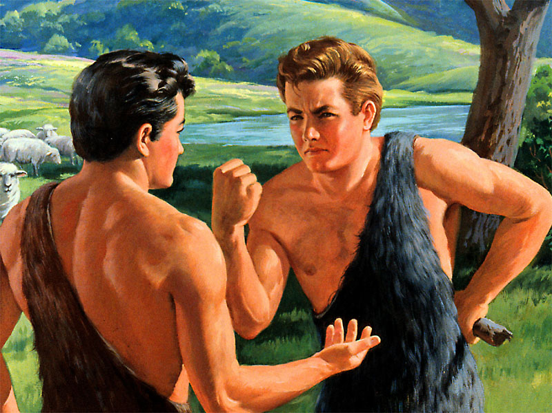
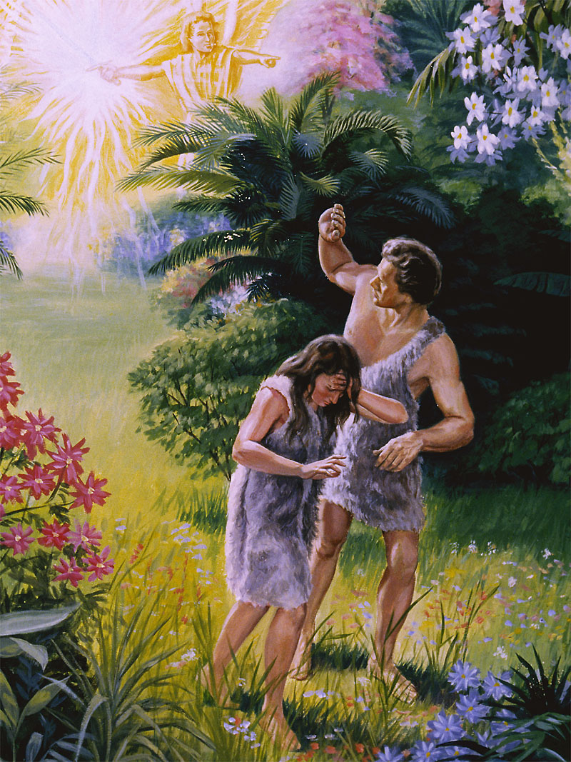
CHURCH: Didn’t even get off to a good start

Slide 16
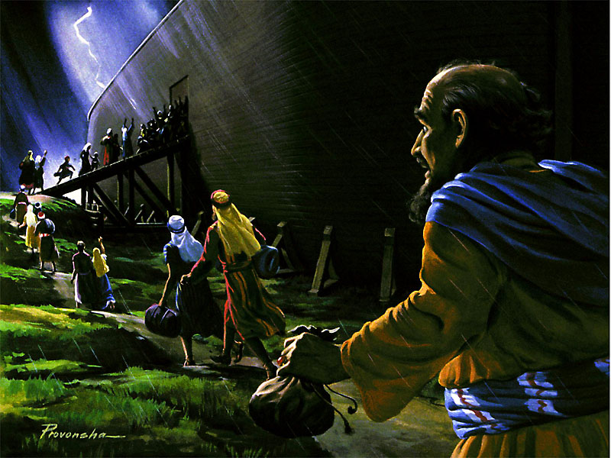
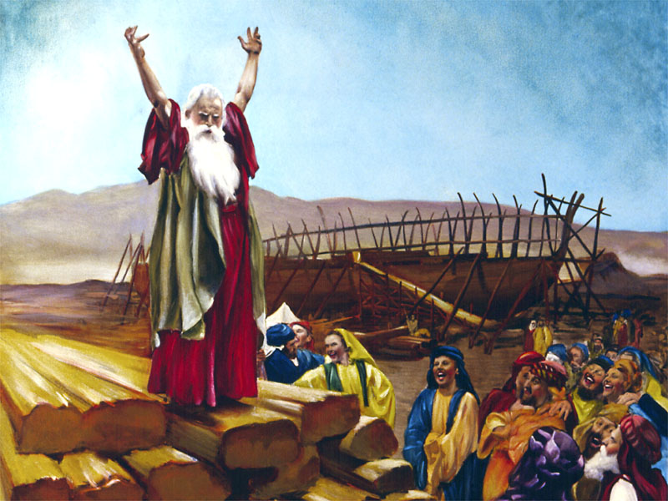
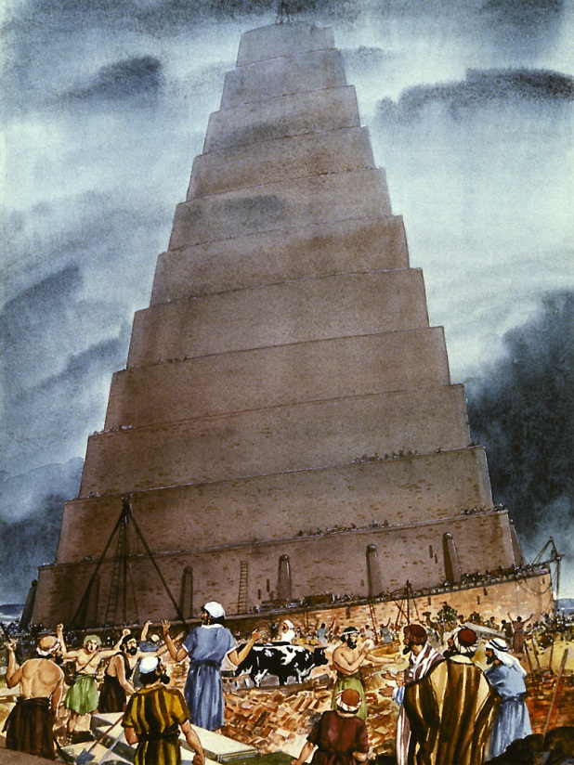
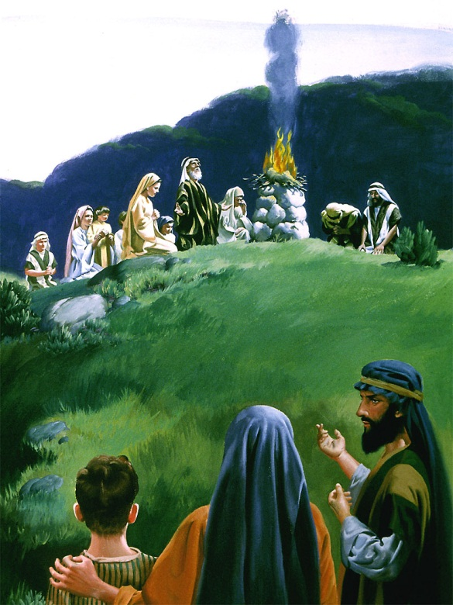
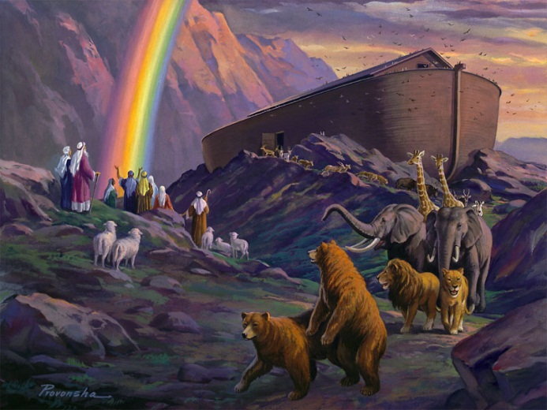
From there it went terribly downhill

Slide 17
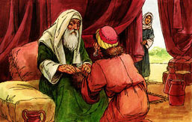
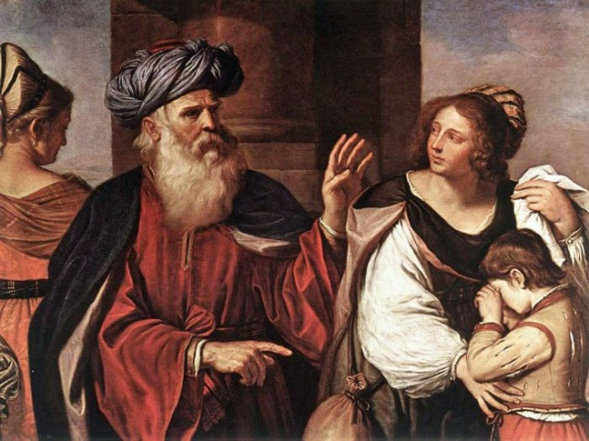
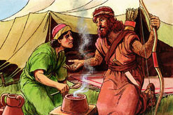
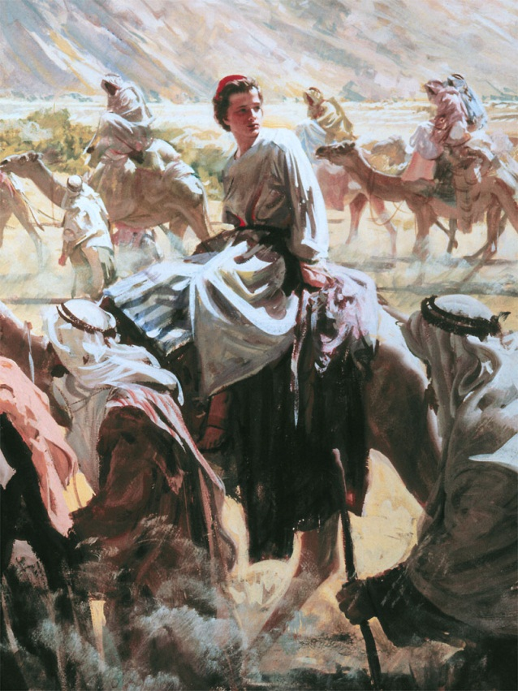
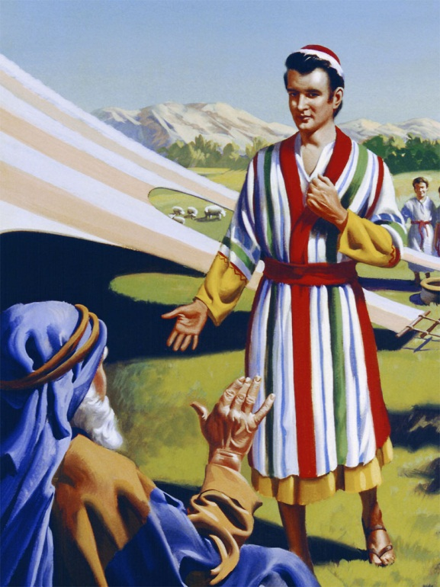
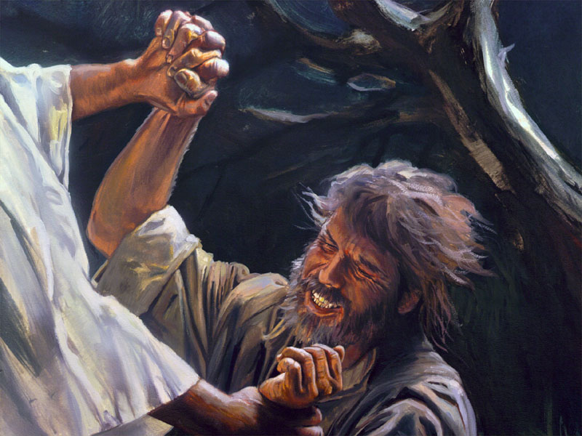
It seemed unable to improve itself

Slide 18
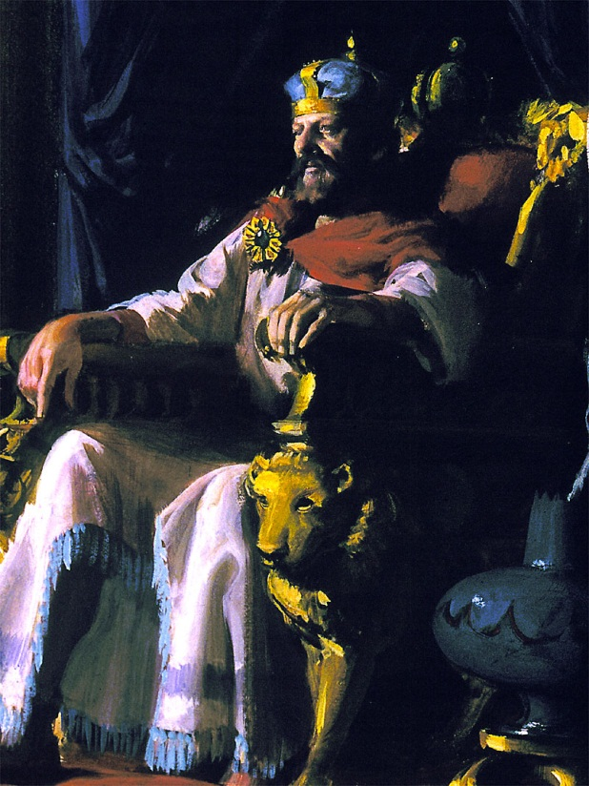
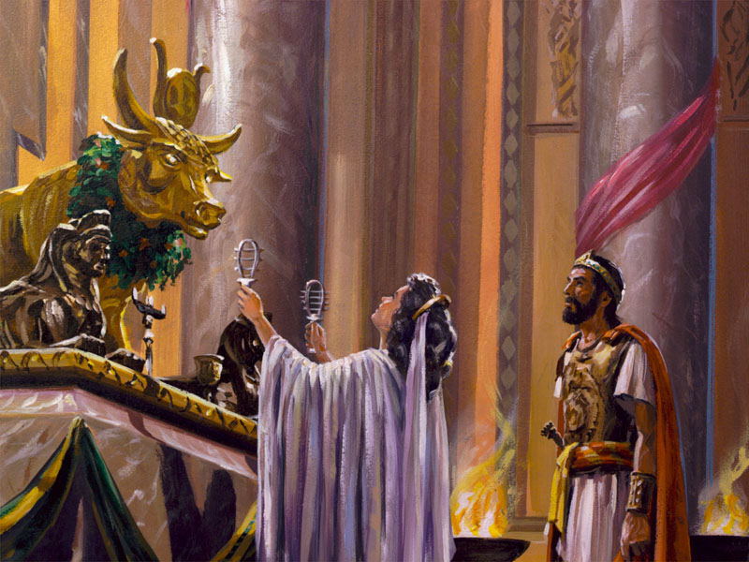
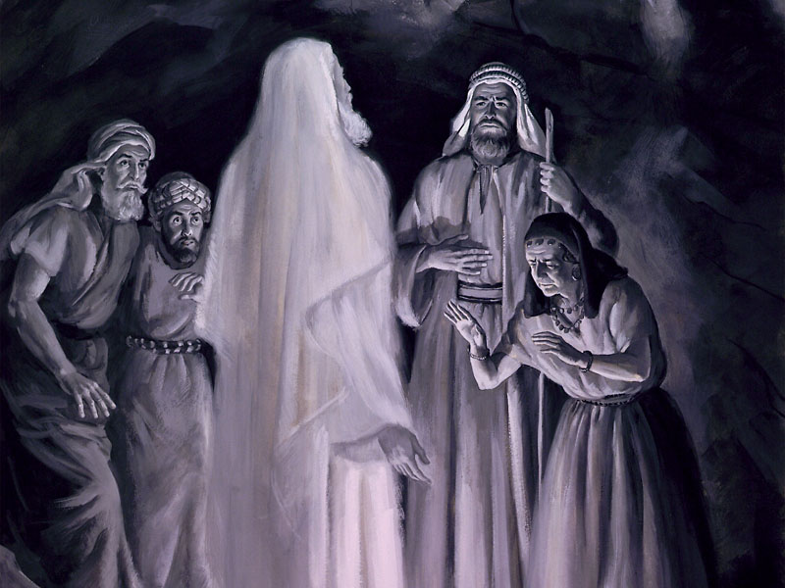
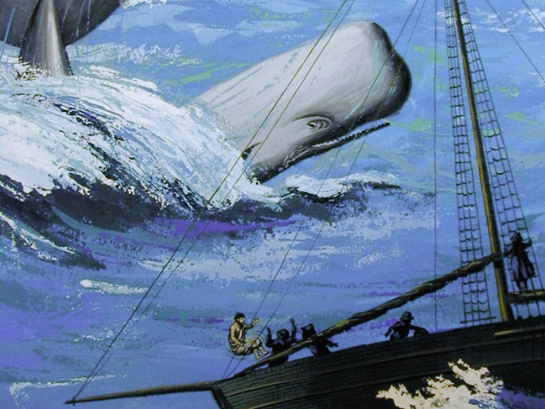
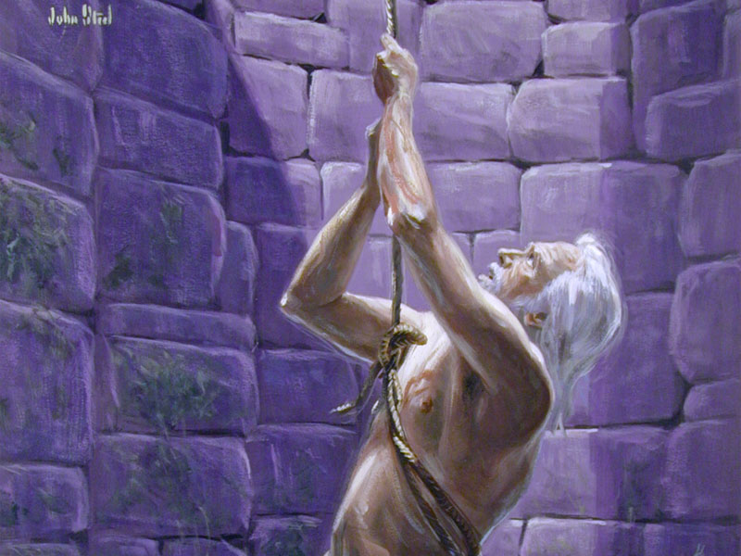
In freefall

Slide 19
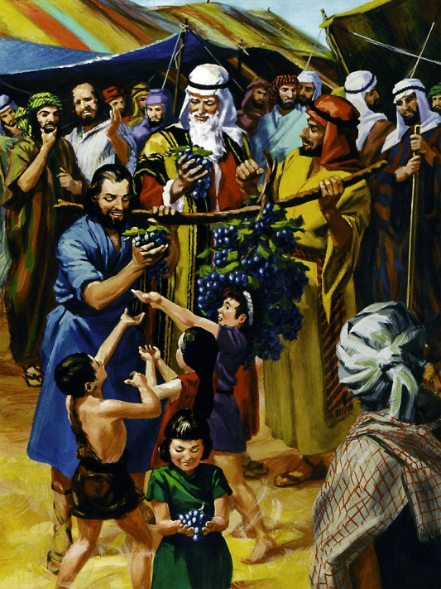
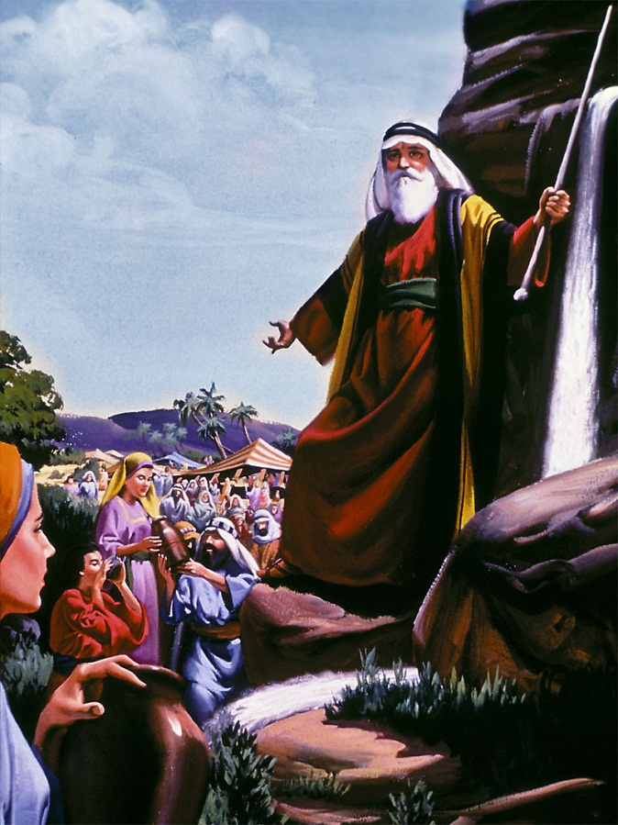
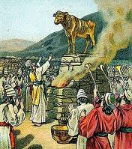
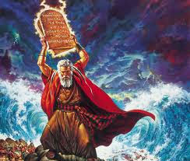
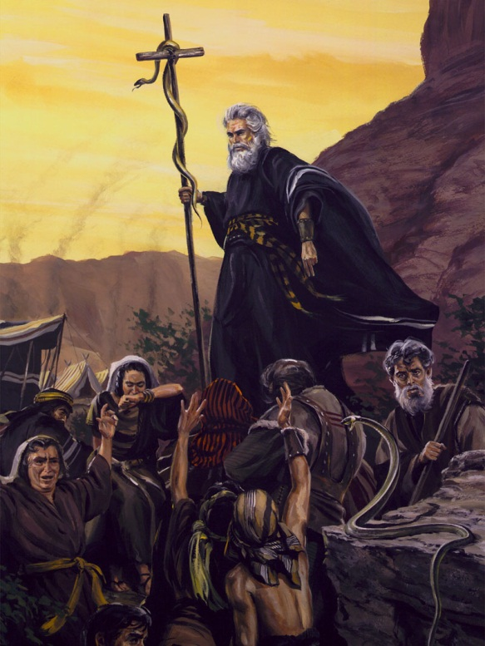
2,500 yrs. of chronic failure

Slide 20
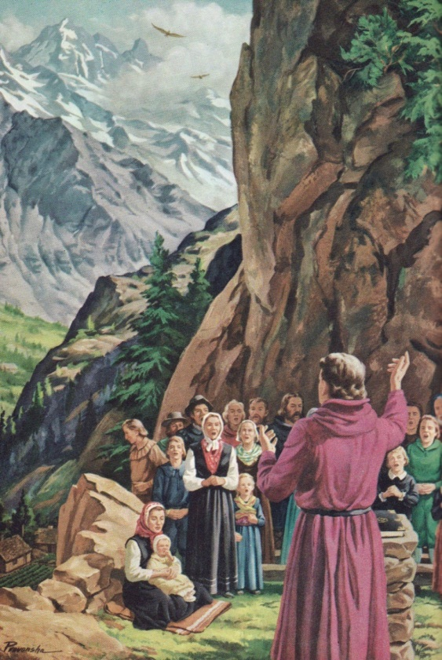
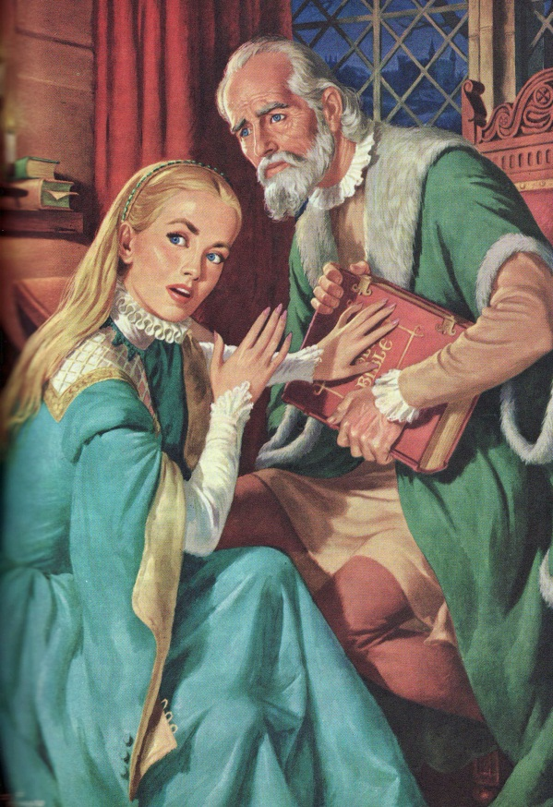
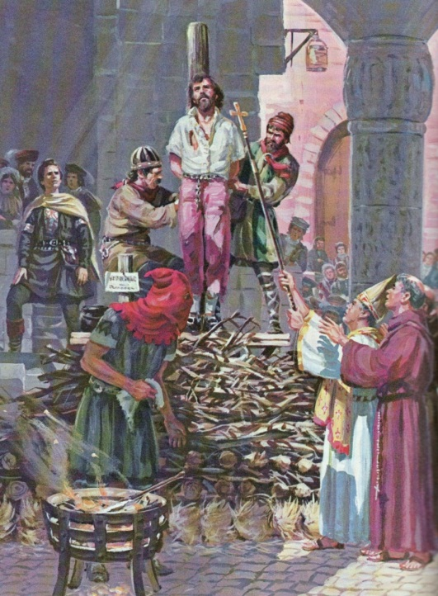
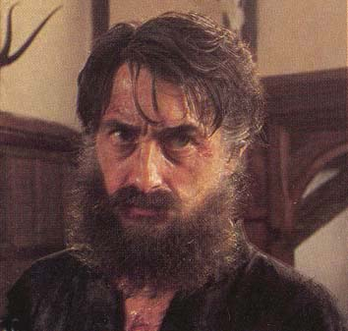
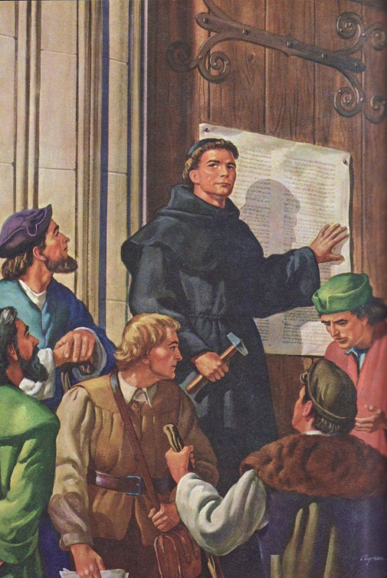
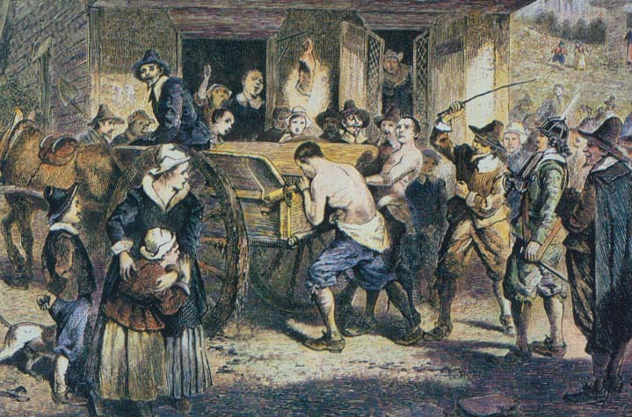
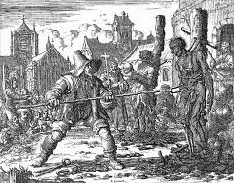
5,500 years…
Puritans persecuting Quakers

Slide 21
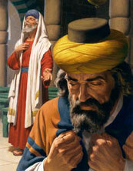
Is the problem God or man?
Two men went up into the temple to pray; the one a Pharisee, and the other a publican.
The Pharisee stood and prayed thus with himself, God, I thank thee, that I am not as other men [are], extortioners, unjust, adulterers, or even as this publican. I fast twice in the week, I give tithes of all that I possess.
And the publican, standing afar off, would not lift up so much as [his] eyes unto heaven, but smote upon his breast, saying, God be merciful to me a sinner. “ Luke 18:10-13

Slide 22
Who were the Pharisees?
Positives:
Credited with preserving knowledge and sanctity of the law, believed scripture was God given
Passionate keeping of the law resulting in them being revered for their piety
Emphasized education and evangelism, tithe paying
Enthusiastic believers in the promised Messiah and fiercely believed they were the chosen
National heroes
Negatives:
External and legalistic focus
They believed they knew everything and had no need for further teaching
Intolerance of others (their size fits all)
Humility was a sign of weakness
They were unloving and harsh
Matthew 23

Slide 23
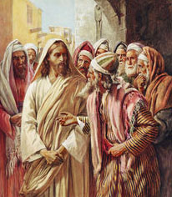
Jesus rejected Pharisaism
He denounced them as hypocrites, offspring of vipers and serpents and blind guides
Denying that their righteousness qualified them for entrance into heaven
Publicans and harlots would be there - But not them
He remained indifferent to their ascetic practices, levitical purity, and their style of Sabbath keeping
The whole spirit of his life was in flat contradiction to their most cherished convictions
They made Church a curse (darkness/void):
A place of trickery, judgmentalism, inhumanity
The questions they asked him were not to learn but trap their enemies and turn public attitude against them
Any deviation from norms was sin (one size fits all) judgmentalism
Religion was heartless
Being human (humility) was a sign of weakness

Slide 24
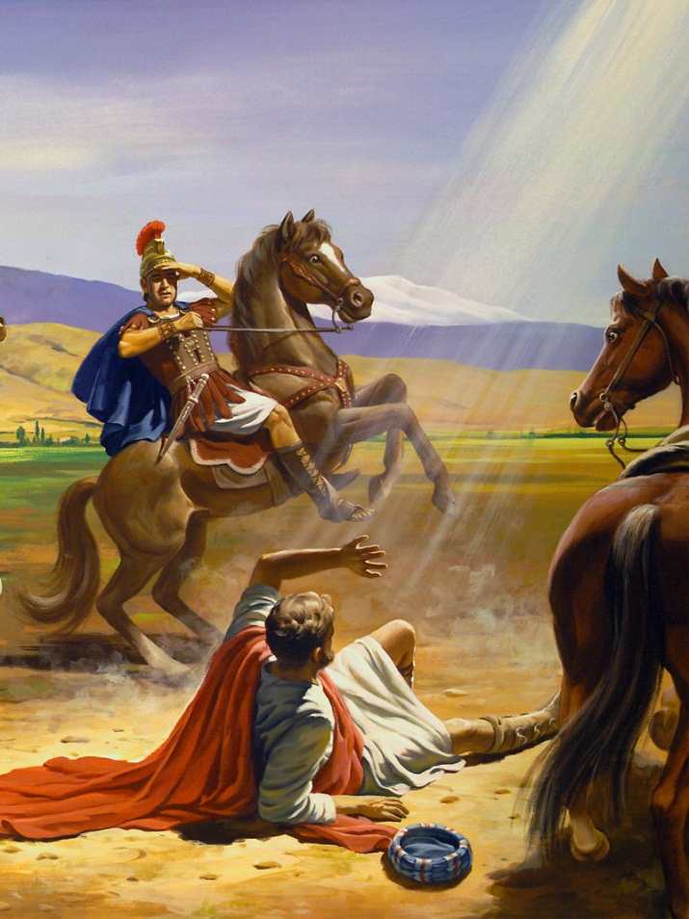
Can Pharisees change?
Though I speak with the tongues of men and of angels, and have not charity,
I am become [as] sounding brass, or a tinkling cymbal.
Though I have [the gift of] prophecy, and understand all mysteries, and all knowledge; and though I have all faith, so that I could remove mountains,
and have not charity, I am nothing.
Though I bestow all my goods to feed [the poor], and though I give my body to be burned,
and have not charity, it profiteth me nothing.
Saul
becomes
Paul

Slide 25
Can Pharisees change?
This is what church is:
Charity suffereth long, [and] is kind; charity envieth not; charity vaunteth not itself, is not puffed up, Doth not behave itself unseemly, seeketh not her own, is not easily provoked, thinketh no evil; Rejoiceth not in iniquity, but rejoiceth in the truth; Beareth all things, believeth all things, hopeth all things, endureth all things. Charity never faileth: but whether [there be] prophecies, they shall fail; whether [there be] tongues, they shall cease; whether [there be] knowledge, it shall vanish away… And now abideth faith, hope, charity, these three; but the greatest of these [is] charity.” 1 Cor. 13:1-8, 13
Saul
becomes
Paul

Slide 26
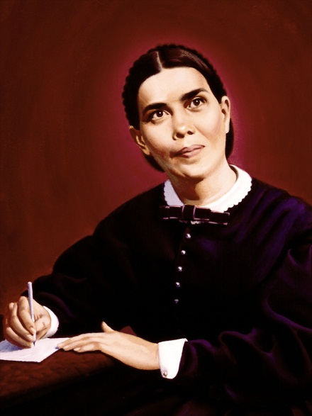
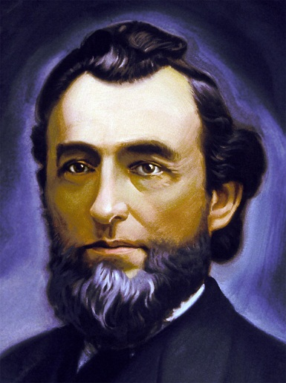
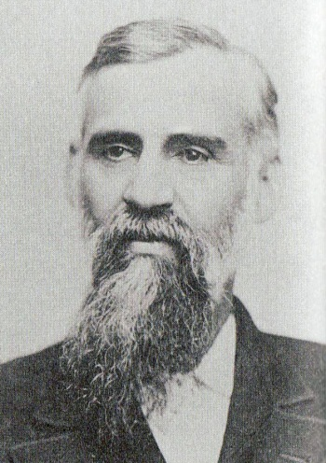
SDA’s battle with Pharisaism
1888 General Conference in Minneapolis
Early Adventism developed a full blown case of Pharisaism
Old guard determined not to be open minded about Righteousness by Faith presented by the two young ministers from the west - Jones (38) & Waggonner (33)
The established church concluded that accepting any of the new teaching would mean all the church had stood for during the past 30 years was erroneous.
That position closed their minds. Error now would become their truth!

Slide 27
SDA’s battle with Pharisaism cont.
EGW was shown the church leadership was intoxicated with the spirit of resistance, forming a confederacy to disallow any change of ideas
Prejudice, unbelief, jealousy, and evil-surmising barred the door of their hearts
A cold iron-like spirit began separating believers from God and one another
Pride, and self-sufficiency, the most hopeless and incurable of sins, settled in their hearts
a cold Satanic criticism , suspecting others of evil intentions was labeled discernment!
priding themselves as being defenders of the truth while in truth they became traitors to the cause
EGW was shown whomever trusted in his own righteousness will despise others - the same spirit that lived in Satan and the Pharisees, lived in them!

Slide 28
SDA’s battle with Pharisaism cont.
Ellen White’s Conclusions
Justification is wholly of grace and not procured by any works that fallen man can do. Anything other than that heaven would consider treason
As late as September 1889, EGW said less than 1% of SDA’s understood the basics of the plan of salvation
“We have talked the law. This is right. But we have only casually lifted up Christ as the sin-pardoning Saviour”
"The churches have been cherishing a spirit which God cannot approve and unless they humble their souls before God and possess a different spirit, they will reject God's light and follow spurious lights to the ruin of their own and many other souls.“
“For years” she declared, “I have seen that there is a broken link which has kept us from reaching hearts. This link is supplied by presenting the love and mercy of God.“

Slide 29
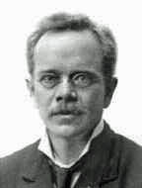
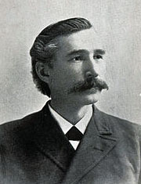
SDA’s battle with Pharisaism cont.
Ellen White’s Conclusions
"Of one thing I am certain, as Christians you have no right to entertain feelings of enmity, unkindness, and prejudice toward Dr Waggoner, who has presented his views in a plain, straightforward manner, as a Christian should.
Some interpretations of Scripture given by Dr Waggoner I do not regard as correct. But I believe him to be perfectly honest in his views, and I would respect his feelings and treat him as a Christian gentleman. . .
The fact that he honestly holds some views of Scripture differing from yours or mine is no reason why we should treat him as an offender, or as a dangerous man, and make him the subject of unjust criticism. . . . No one should feel at liberty to give loose rein to the combative spirit." Nov. 1888, Mss 15

Slide 30
What is God’s Church like?
The fundamental difference between the Pharisee and Publican was:
Pharisees believed righteousness was earned by obedience to the law
The Publican knew in his heart that Christ’s righteousness must be a free gift pleads “God be merciful to me a sinner”
Our strength comes from Christ’s Righteousness, not our own!
There is no power in the law to save
Boasting in our own works robs us from boasting in Christ!
Trusting in our own understandings had a crushing influence on the church in 1888

Slide 31
SDA’s battle with Pharisaism cont.
Ellen White’s Conclusions
In December of 1888, after noticing the spirit of those who defended the old position on Galatians, Ellen White observed:
"For the first time I began to think it might be we did not hold correct views after all, upon the law in Galatians, for the truth required no such spirit to sustain it."
At an 1890 Ministerial Institute she said:
"I am afraid of you and I am afraid of your interpretation of any scripture which has revealed itself in such an unchristlike spirit as you have manifested and has cost me so much unnecessary labor. . . . I say if your views on the law in Galatians, and the fruits, are of the character I have seen in Minneapolis and ever since up to this time, my prayer is that I may be as far from your understanding and interpretation of the Scriptures as it is possible for me to be. I am afraid of any application of Scripture that needs such a spirit and bears such fruit as you have manifested. One thing is certain, I shall never come into harmony with such a spirit as long as God gives me my reason. . .”

Slide 32
SDA’s battle with Pharisaism cont.
Ellen White’s Conclusions
continuing…
“The most convincing testimony that we can bear to others that we have the truth is the spirit which attends the advocacy of that truth. If it sanctifies the heart of the receiver, if it makes him gentle, kind, forbearing, true and Christlike, then he will give some evidence of the fact that he has the genuine truth.” March 13, 1890
“men to suppose they are appointed to criticize and condemn their brethren are to be feared and shunned.” Ellen White to A G Daniells, December 14, 1903
"Those who are so eager to find fault know not what spirit they are of” July 23, 1889

Slide 33
What is God’s Church like?
Nov. 15, 1888 she wrote:
“Man begins to comprehend himself when he takes his place at the feet of Jesus. When men turn their attention away from earthly things, and look heavenward, when they obtain glimpses of the heavenly glory, they discern more clearly the depths of the human heart, and see the depravity of the soul.”
The Publican:
knowing he had no merit to commend him to God, in utter self-despair he cried, 'God be merciful to me, a sinner.‘

Slide 34
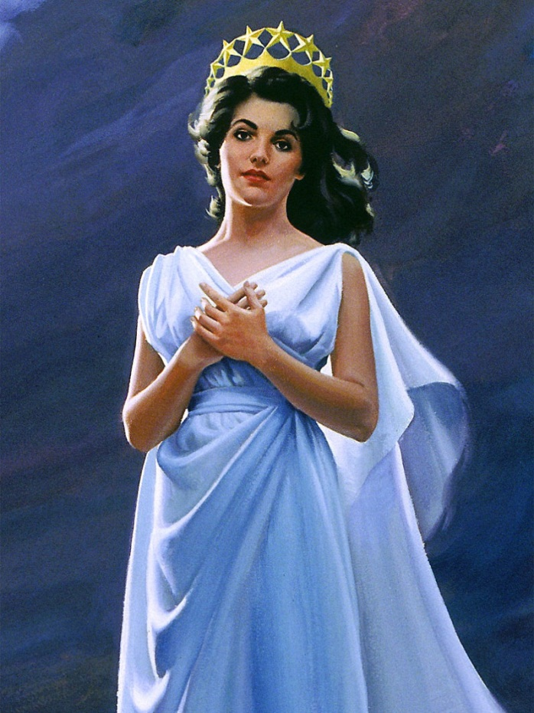
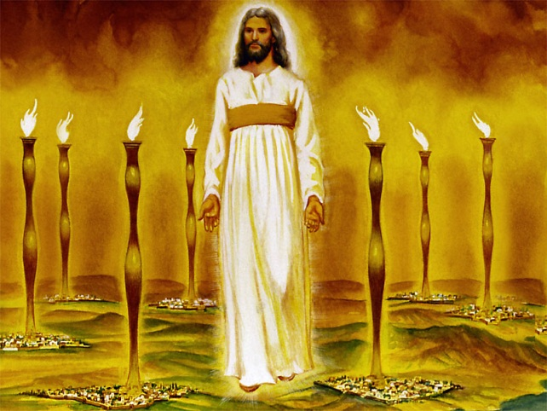
The Good News about Church is:
God
Who refuses to give up on us
HIS GRACE IS NEVER ENDING
He is unbelievably patient and remarkably forgiving
Who believes in us
HIS CONFIDENCE NEVER WAINS
“My grace is sufficient for thee: for my strength is made perfect in weakness.” 2 Cor. 12:9
His faith makes it so
Who loves us
HIS FOCUS is ALWAYS UPON OUR HEARTS
The key to true Christianity
God’s people will be:
HUMBLE & TEACHABLE – open, learners
LOVING & LOVABLE – know the heart
BEAUTIFUL FROM THE INSIDE OUT - meek
This IS good news. He rejoices over his Church with singing - Zeph. 3:17
Because of this - the church cannot fail! God strength is made perfect in weakness – 2 Cor. 12:9

Slide 35
AMEN

Slide 37
"Look unto Me, and be ye saved, all the ends of the earth: For I am God, and there is none else."
Isaiah 45:22.

Slide 38
What should Church be like?
There is no earthly comparison
"Whereunto shall we liken the kingdom of God? or with what comparison shall we compare it?" Mark 4:30
Earthly kingdoms rule by physical power vs. Christ’s church which:
Banishes every carnal weapon, every instrument of coercion
uplifts and ennobles humanity
promotes spirituality and holy living
Is filled with gifts and endowed with the Holy Spirit
Its members find their happiness in the happiness of those whom they help and bless
Ezekiel (47:8-12)pictured it as healing waters which give birth to noble trees that sustain and heal us
i.e. Joseph and Daniel who were well-springs of blessing to Egypt and Babylon
What they received from God flowed unrestricted to others
Revealing the character of God to all mankind
Church should be Godlike!
A place where God is present and realized
Notes:
(AA 12)

