Slide 1
The Good News about The Remnant
Willits March 17, 2012
Fort Bragg, April 14, 2012

Slide 2
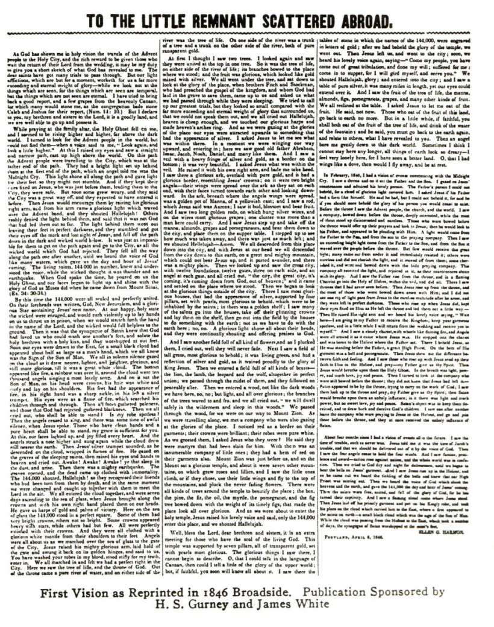
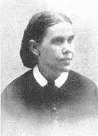
Ellen White received her first vision in Dec. 1844. Her second came in the spring of the following year. These two visions became the subject of the first Seventh-day Adventist pamphlet published in 1846 (approximately 15 years before the church was organized) in a broadside entitled “To the Little Remnant Scattered Abroad”.
Adventism and the Remnant

Slide 3
Adventism and the Remnant
1849 – Joseph Bates – The Advent Movement is the fulfillment of Rev. 12:17
1853 - Ellen White referred to Sabbath-keeping Adventists as “the remnant people of God.”
1855 - J. M. Stephenson was urged to reconsider severing himself from “the remnant people of God.”
1856 – Uriah Smith explained why Adventists considered themselves the remnant
1857 – James White likewise defended why Adventists considered themselves the remnant

Slide 4
Adventism and the Remnant
When considering a name for our church “The Remnant” was one of the options
For almost 175 years books and periodicals have rolled off Adventist presses calling this movement “the remnant church.”
The denomination officially established it as doctrine during its 1980 General Conference session in Dallas.
No other church claims this unique distinction.

Slide 5
The Remnant in the Bible
Six Hebrew words used to depict remnant:
peleṭah (or paleṭ, paliṭ), “what escapes,” “those who escape,” from palaṭ, “to escape,” “to deliver”
she’erith (or she’ar), “the rest,” “what remains,” “remainder,” “remnant,” and its verb form sha’ar, “to leave over,” “to be left over,” “to remain”
yether, “what remains,” “remainder,” “remnant,” from yathar, “to leave over,” “to be left over.”
malat (slip”)
sarad (“to escape”)
‘achar (“to delay,” “to tarry”)
This concept can be traced throughout the bible even if these words are not used.

Slide 6
Biblical examples:
The Antidilluvian World:
An evil situation:
“God saw that the wickedness of man [was] great in the earth, and [that] every imagination of the thoughts of his heart [was] only evil continually. And it repented the LORD that he had made man on the earth, and it grieved him at his heart.” Gen. 6:5,6
The rest of mankind “corrupted his way upon the earth” (Gen. 6:12)
God saved a remnant:
After “every living substance” (Gen. 7:4) was blotted out, only Noah and his clan survived. (Gen. 7:23)

Slide 7
Biblical examples:
Noah = Remnant:
Why was Noah selected to survive (remnant)?
He was a “just man and perfect in his generations, and [that] Noah walked with God” (Gen. 6:9)
The Lord said of him “thee have I seen righteous before me in this generation” (Gen. 7:1)
And Noah did “all that God commanded him” (Gen. 6:22)
On this basis, God said:
“With thee will I establish my covenant” (Gen. 6:18)

Slide 8
What about remnant children?
What about Noah’s posterity?
Noah failed to pass remnant status to his children.
In just a few generations after the flood, most of Noah’s posterity were in full blown rebellion against God (i.e. the tower of Babel)
Later, a descendant of Noah (via his righteous son Shem) named Terah was a moon-worshipper (Josh. 24:2; Ur and Haran were centers of moon worship - SDABD)
Abram, his son, needed to leave his idolatrous family in order to follow God (Gen. 12:1).
Rachel (Abram’s grandson’s wife) worshipped idols (Gen. 31)

Slide 9
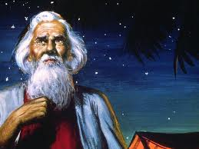
Patriarchal Remnant…
Abraham
entered into a covenant/remnant
relationship with God
“when Abram was ninety years old and nine, the Lord appeared to Abram and said unto him, I am the Almighty God; walk before me, and be thou perfect. And I will make my covenant between me and thee, and will multiply thee exceedingly” (Gen. 17:1,2).
Abraham was called the Friend of God.” Jas. 2:23 [see also Isa. 41:8]. Even His friend forever 2 Chron. 20:7
Why?
“I know him, that he will command his children and his household after him, and they shall keep the way of the LORD, to do justice and judgment; that the LORD may bring upon Abraham that which he hath spoken of him.” Gen. 18:19

Slide 10
Patriarchal Remnant…
Despite some obvious flaws…
Lying and not trusting God
Abraham maintained his intimate relationship with God in a world that didn’t.
“By faith Abraham, when he was called to go out into a place which he should after receive for an inheritance, obeyed; and he went out, not knowing whither he went. By faith he sojourned in the land of promise, as [in] a strange country, dwelling in tabernacles with Isaac and Jacob, the heirs with him of the same promise: For he looked for a city which hath foundations, whose builder and maker [is] God.” (Heb. 11:8-10)

Slide 11
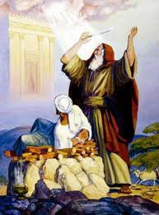
Patriarchal Remnant…
Isaac became the remnant too:
God declared “My covenant will I
establish with Isaac, which Sarah shall
bear unto thee at this set time in the next year”
(Gen. 17:21)
Isaac was to live a life of obedience, godliness, and intimacy with God – attitude on Mt. Moriah
Not all of Isaac’s children become remnant
Esau fathered a pagan nation
Ishmael benefited from God’s promises, but the remnant didn’t come through him

Slide 12
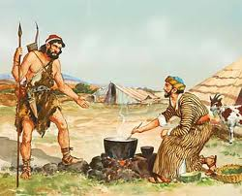
Patriarchal Remnant…
Esau & Jacob…
Esau, by birth, should have been
the recipient of the remnant/birthright privileges
but his disregard for it allowed him to sell it for “one morsel of meat” (Heb. 12:13, see also Gen. 36:8).
Jacob, his brother, esteemed the birthright so highly he was willing to obtained it by fraud (Gen. 27)
Later he wrestled all night with an unknown assailant. Realizing his opponent was the Lord, he clung to him for a blessing (Gen. 32:26) .

Slide 13
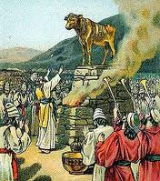
Patriarchal Remnant…
Israel wanted the privileges but not the intimacy of the remnant relationship
At Mt. Sinai-
“Now therefore, if ye will obey my voice indeed, and keep my covenant, then ye shall be a peculiar treasure unto me above all people: for all the earth is mine: And ye shall be unto me a kingdom of priests, and an holy nation” (Exodus 19:5, 6)
Throughout it’s history
From the golden calf (Ex. 32) to the stoning
of Stephen (Acts 7) fifteen hundred years
passed, during which they never
lived up to their remnant promise
The record of their failure fills the OT

Slide 14
The Prophets railed them for their failure
Isaiah declared them a total failure:
“The whole head is sick, and the whole heart faints. From the sole of the foot even to the head, there is no soundness in it, But wounds and bruises and putrefying sores” (Isa. 1:5,6 NKJV)
Malachi accused them of duplicity:
“Ye have wearied the Lord with your words. Yet ye say, Wherein have we wearied him? When ye say, Every one that doeth evil is good in the sight of the Lord, and he delighteth in them; or, Where is the God of judgment?” (Mal. 2:17).

Slide 15
God was fed up with their failure
Their worship was an abomination to him:
“I am full of the burnt offerings of rams, and the fat of fed beasts…. And when ye spread forth your hands, I will hide mine eyes from you: yea, when ye make many prayers, I will not hear” (Isa. 1:11, 15
“Bring no more vain oblations; incense is an abomination unto me; the new moons and Sabbaths, the calling of assemblies, I cannot away with; it is iniquity, even the solemn meeting” (Isa. 1:13).

Slide 16
Even Jesus couldn’t fix the problem
Before His death, on Mt. of Olives, Jesus looked over Jerusalem, with tears crying out:
“O Jerusalem, Jerusalem, thou that killest the prophets, and stonest them which are sent unto thee, how often would I have gathered thy children together, even as a hen gathereth her chickens under her wings, and ye would not! Behold your house is left unto you desolate.” (Matthew 23:37,38)

Slide 17
God lays down an ultimatum
After the Babylonian captivity, God’s patience was exhausted, he warned those who returned:
there would be “no remnant nor escaping” should they again prove disloyal to Him (Ezra. 9:14; cf. Deut. 19:20)
When the Jews rejected the Messiah:
the “kingdom of God” would be taken from them and “given to a nation bringing forth the fruits thereof” (Matt. 21:43; cf. 1 Peter 2:9, 10).
permanently, irrevocably canceling their special standing before God as a nation
That would be transferred to the Christian church

Slide 18
A NEW Remnant…
Christianity
Disciples gathered in the Upper Room
Prayer, the Holy Spirit fell
The fearful became fearless – building a new church
new remnant confronting former remnant
Deacons
Phillip (a Greek) – was led to open the way for the formerly unacceptable to join the church – the Ethiopian Eunuch
Stephen (a Greek) – brings Saul (a Roman/Jew) under conviction
Saul becomes Paul (persecutor to champion of the new remnant)
Gospel to the Gentiles
Reframing the theology of the church

Slide 19
The Christian Remnant?
Yet problems persisted
fornication – 1 Cor. 5:1
ethnic bigotry – Acts 6:1
backsliders – 2 Peter 2:19-22
false teachers – 2 Peter 2:1; 3:16
busybodies and tattlers – 1 Timothy 5:13
theological disputes – Acts 15:1,2
false theology – Gal. 3:1; 2 Tim. 2:17
Paul warned of a great “falling away” (2 Thess. 2:3).
John shown problems existing in several churches (Rev. 2:20; 3:4) requiring repentance (Rev. 2:16).

Slide 20
Forever struggling Remnant
Catholic/Protestants clashes:
Persecuted become persecutors
Calvin burns his heretics
Zwingli drowns his
Luther urges the state to “smite, slay and stab, secretly or openly… as if among mad dogs” peasants who had revolted – (Hitler used Luther to justify the holocaust)
Protestant churches soon subscribed to such teachings as:
predestination, once-saved-always-saved, antinomianism (no need of the law), infant baptism, the immortal soul, and an earthly millennium.
Within a few centuries, rationalism, denial of the supernatural, evolution, the denial of Christ’s deity entered many denominations

Slide 21
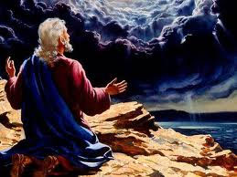
John’s view of the Remnant
Exiled on Patmos
Questioning: would the remnant ever arrive?
Jesus reassures him:
by revealing the entire history of good vs. evil
The Great Controversy between Lucifer and Christ
Beginning in heaven before creation to its final resolution
Heaven is already rejoicing
A faithful remnant is found
Global judgment will happen
The wicked are destroyed
God and remnant reunited

Slide 22
Who are the Remnant?
“And the dragon was wroth with the woman, and went to make war with the remnant of her seed, which keep the commandments of God, and have the testimony of Jesus Christ.” Rev. 12:17
Are SDA’s the Remnant?
We appear on time at the end of the 1260 prophecy
We keep the commandments of God (incl. Sabbath)
We have “the testimony of Jesus” = Spirit of prophecy (Rev. 19:10)
No one but Adventists fulfill these prerequisites!
Is the SDA church the remnant?
Or does it possess the qualifications of the remnant?

Slide 23
Who are the Remnant?
In God’s view, never has the remnant been the result of:
Biology (Jewish fallacy)
Organization (Roman Catholic Church fallacy)
Creedal statements (Adventist fallacy)
The remnant have always been:
Those who sincerely keep God’s law (as Jesus defined it in his Sermon on the Mount)
People who have walked with God (righteous)
A love relationship between God and mankind
Whenever a remnant failed to live up to its calling it’s mantle was passed to others

Slide 24
God’s role in bringing it about…
“In that day the Lord will reach out his hand a second time to reclaim the remnant that is left of his people from Assyria, from Lower Egypt, from Upper Egypt, from Cush, from Elam, from Babylonia, from Hamath and from the islands of the sea.” (Isa. 11:11 NIV)
“I will bring them, and they shall dwell in the midst of Jerusalem: and they shall be my people, and I will be their God, in truth and in righteousness” (Zechariah 8:8)

Slide 25
God’s role in bringing it about…
“I myself will gather the remnant of my flock out of all the countries where I have driven them and will bring them back to their pasture, where they will be fruitful and increase in number. I will place shepherds over them who will tend them, and they will no longer be afraid or terrified, nor will any be missing,” declares the Lord.”(Jer. 23:3,4 NIV)

Slide 26
The Good News about the Remnant
God is faithful
Forever keeping his promise
Extremely patient with us
He is amazingly forgiving
God will succeed
Theme in Revelation is:
Jesus already has gained the victory
All his promises will come true
The Remnant isn’t a closed group
Open to all
Not something inherited

Slide 27
Are Adventists the Remnant?
“And the dragon was wroth with the woman, and went to make war with the remnant of her seed, which keep the commandments of God, and have the testimony of Jesus Christ.” Rev. 12:17
Are we obedient to God?
Do we walk with God?
Are we preparing our children to be godly?
Are we people of faith?
Is our worship empty and repulsive to God?
Are we God’s treasure, a sweet savor?

